Slide 1


The Spot Image Solution
Alan Kittson and Drew Hopwood
Spot Image Corporation
(703) 715-3100
Statewide Digital Mapping Initiative
Imagery Workshop

Slide 2
SPOT’s Solution is Ideally Suited to Meet ALL of the
SDMI Imagery collection requirements and mandates TODAY!
Time
  Complete Coverage in 3 Years
Coverage
  Swath and collection capacity
  Extensive Imagery Archive of Alaska
Added Benefits
  Emergency Response Services
  Monitoring Capabilities
  Extensive Archive of Alaska
Experience
  A 25 Year Legacy of Quality, Accuracy, Experience & Success
  Demonstrated Collection Capability

Slide 3
SDMI Objective
Create a Seamless, consistent, statewide coverage of ortho-imagery which meets the National Mapping Accuracy Standard 1:24,000
Cartographic foundation
  Economic development
  Environmental assessment and monitoring
  Homeland security
  Personal safety
  Numerous other societal requirements
Mapping all of Alaska in less than 5 Years

Slide 4
The Components
Key Components to the success of the SDMI project:
Control
Challenges:
1.4M km²
Short collection window
Climatic conditions
Challenges:
No map source
New GCP collection
Imagery
Elevation
Model
Challenges:
Uncertain DEM
Challenges:
Production volume
Production

Slide 5
Imagery Overview
Imagery
You Need 1.4M km² of coverage in < 5 years
Product characteristics
  Spectral bands
  Resolution
  Sensor capability
  Revisit and Swath Width
Accuracy
  Native Horizontal
  Improved Horizontal
Applications
  Land Cover
  Transportation and Infrastructure
  Environmental Analysis
  Public Safety and Military

Slide 6
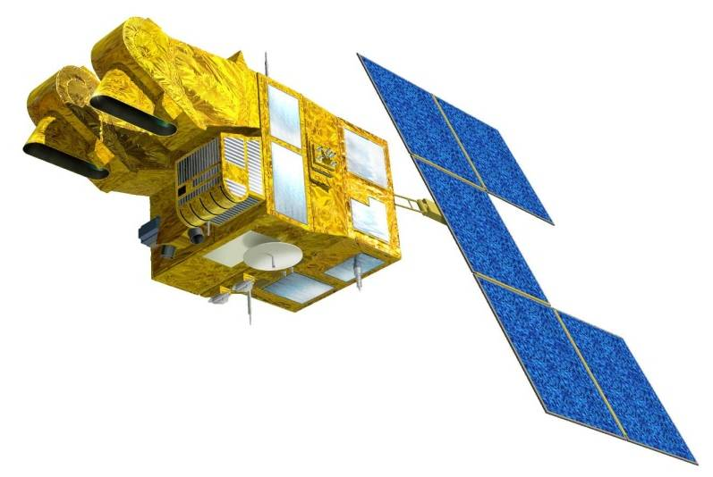
SPOT-5 Characteristics
Imagery
We offer SPOT-5
SPOT-5 contains four sensors
  Two High Resolution Geometry (HRG) sensors
  High Resolution Stereo (HRS) sensor
  1km Vegetation (VGT) sensor
HRG data will be used for the SDMI
  Resolution
    2.5m and 5m Panchromatic
      Pan (0.48-0.71 μm)
    10m Multispectral
      Green (0.50-0.59μm)
      Red (0.61-0.68 μm)
      NIR (0.78-0.89 μm)
      SWIR (1.58-1.75 μm)
  Scene Size at nadir
    60km x 60km
  Accuracy
    Native - 41m CE95
    Improved – 12m CE95
HRG sensors
HRS sensor
VGT sensor

Slide 7
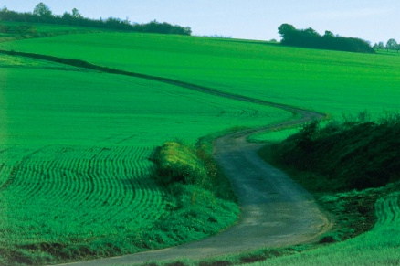
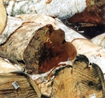
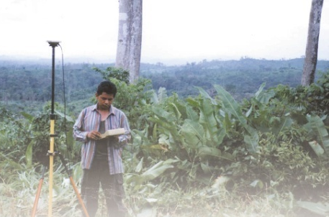

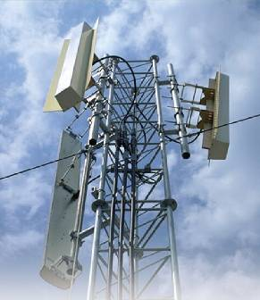
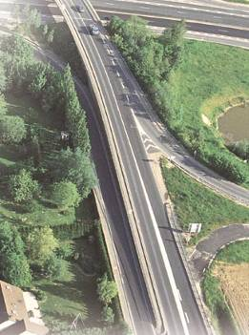
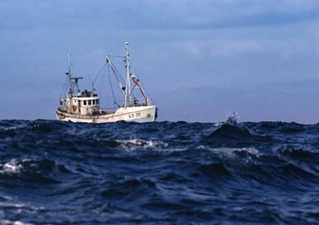
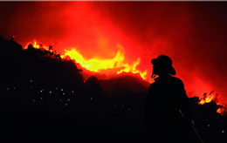
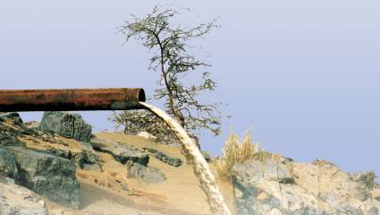
Applications
Imagery
Agriculture
Forestry
Defence, Intelligence
Cartography, Cadastral Mapping
Telecoms
Land planning and management
Disaster management and mitigation
Oil, gas, mineral and groundwater exploration
Fisheries

Slide 8
Imagery – Direct Receiving Station
Imagery
SDMI needs 1.4M km² of coverage in < 5 years
Our solution is a Telemetry Agreement
  Spot recommends a Direct Receiving Station (DRS) solution to meet the stated goals of the SDMI
    Lowest cost solution
    Maximize acquisition of imagery
    Rapid delivery in emergency situations
    Monitoring capability at no additional expense
A DRS provides the foundation for creating a long term mapping program for the State of Alaska

Slide 9
Imagery – Lowest Cost Solution
Imagery
Over 50% savings over “per scene” purchasing
  Plus added benefits
Unlimited satellite tasking
  Standard tasking for SPOT 5
  Address specific needs by agency
Unlimited data acquisition & usage
  Access to SPOT 5 telemetry
  “All You Can Drink” Approach
Fixed annual fee
  Cost overruns eliminated
  Management of annual budgets

Slide 10
Imagery – Maximize Collection Capacity
50% More Collection Capacity Using a DRS Solution

Slide 11
Imagery – Maximize Collection Capacity
Imagery
Up to 5 channels of data can be collected at a time
  2 channel transmitted to the ground
  3 channels recorded on board simultaneously
7 Possible Acquisition Channels
HRG1 multispectral
on board recording
channels
HRG 1
HRG1 panchro A
HRG1 panchro B
OB memory
HRG2 multispectral
HRG 2
HRG2 panchro A
transmission to the ground
HRG2 panchro B
HRS

Slide 12
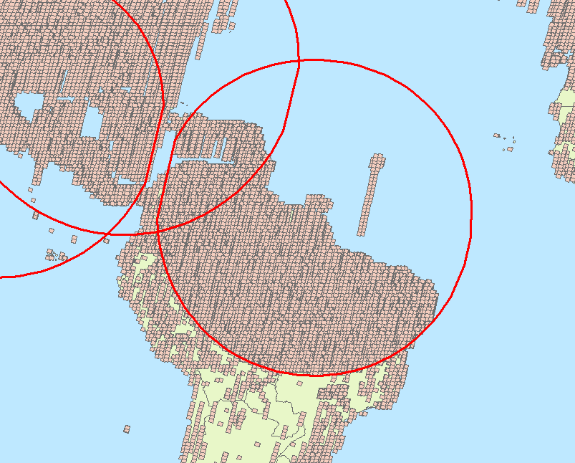
Imagery – Maximize Collection Capacity
Imagery
Example of collection increase
  With DRS vs Without DRS

Slide 13
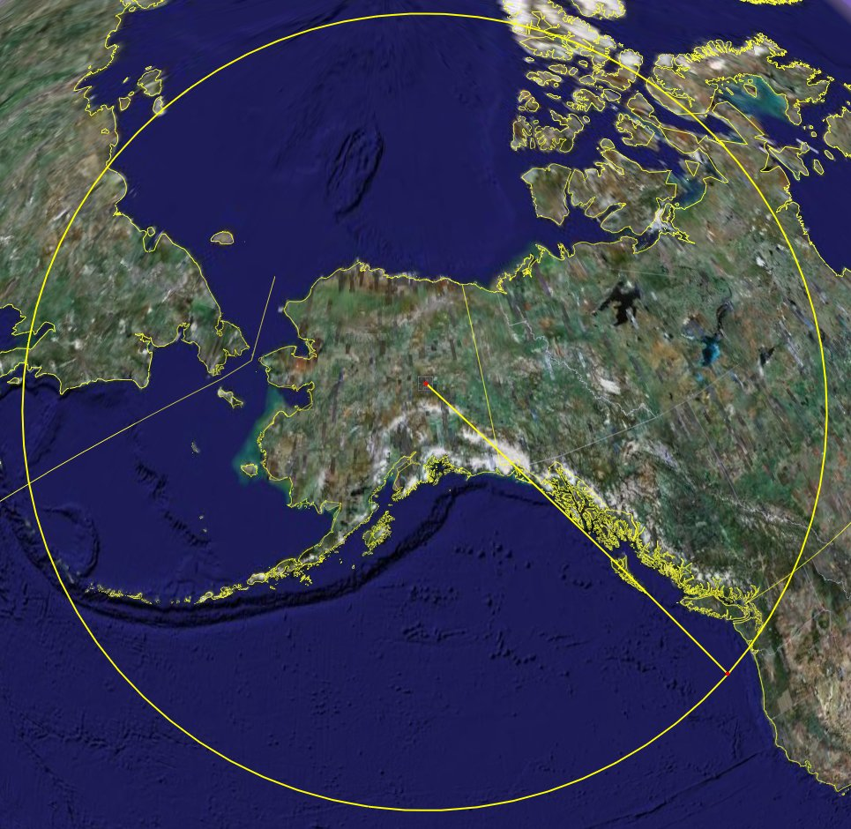
SPOT Collection Capability over Alaska - Example
Visibility circle over Alaska

Slide 14
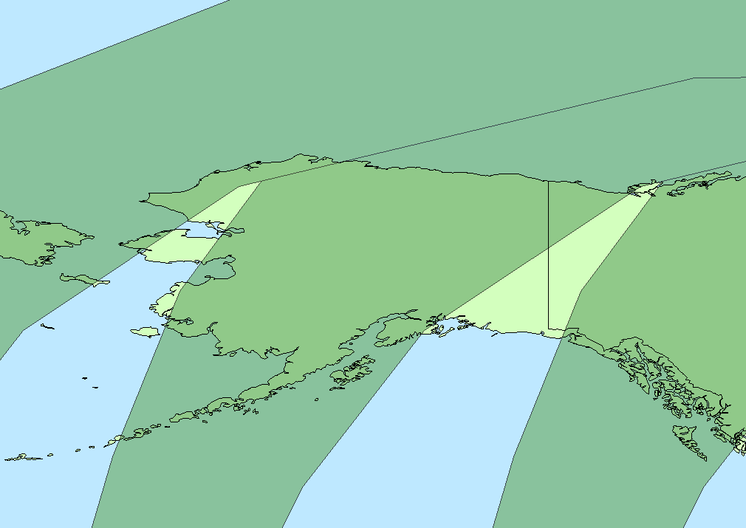
SPOT Collection Capability over Alaska - Example
Imagery
Access corridors

Slide 15
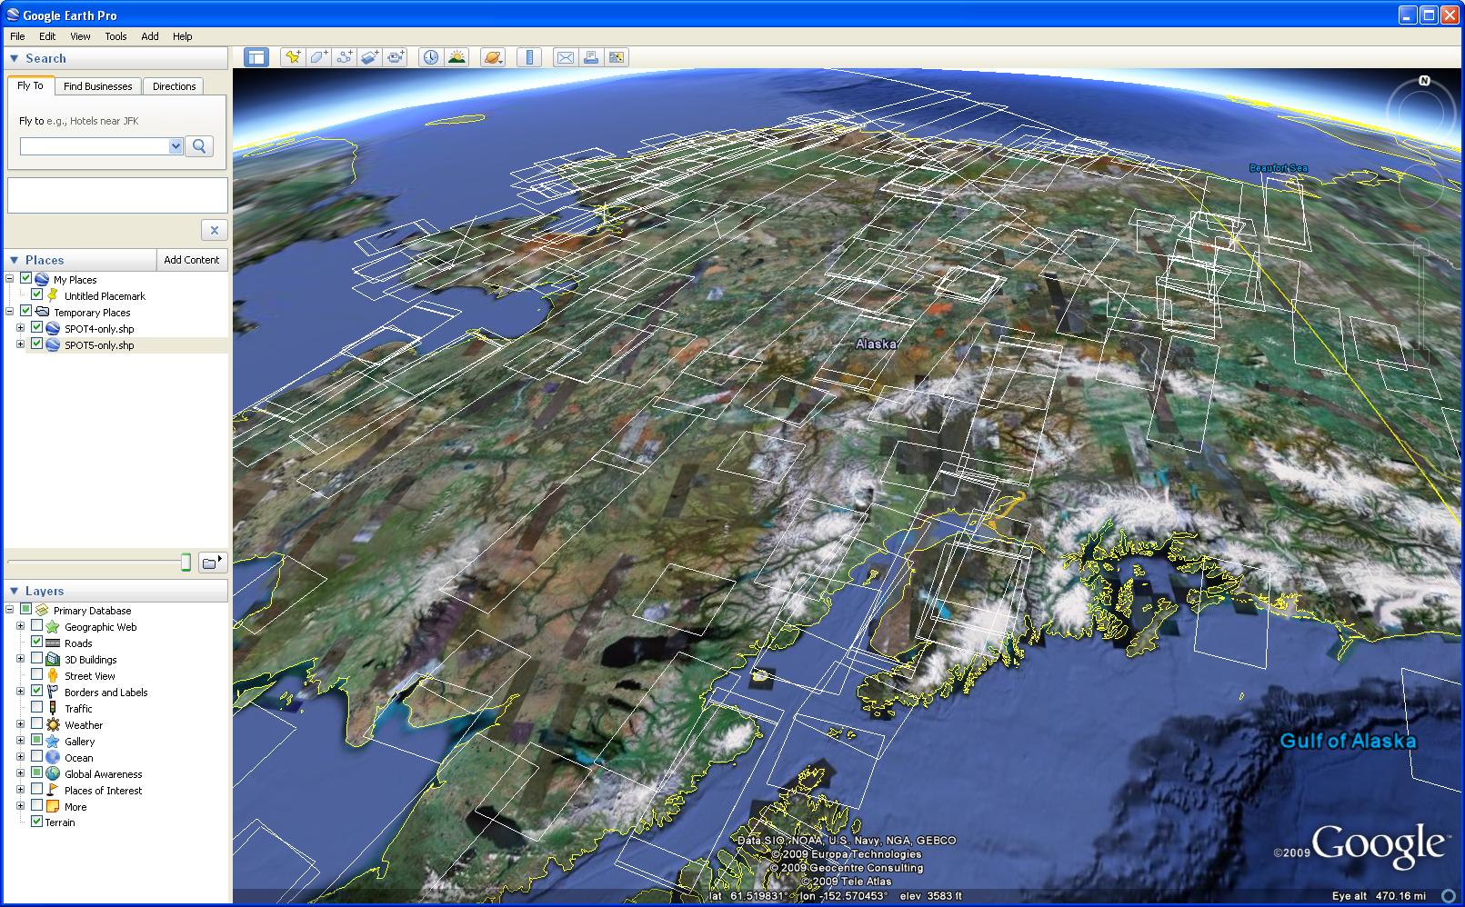
SPOT Collection Capability over Alaska - Example
Imagery
Fact Collection Capacity is key, due to
          the short collection season
Illustration of one week’s collection with SPOT 4 & 5 over Alaska

Slide 16
Benefits of a SPOT Direct Receiving Station
Imagery
Access to telemetry from SPOT 5
Unlimited satellite tasking for SPOT 5
Unlimited imagery acquisition from SPOT 5
  Creation of sustainable image archive
Ability to map the ENTIRE state of Alaska in 3 years or less
Ability to support ongoing state and federal imagery requirements (DNR, NOAA, Weather Service, BLM)

Slide 17
Benefits of a SPOT Direct Receiving Station
Imagery
Long term mapping and imagery capability
  ~60% Annual Refresh Collection
  Disaster Support
  Environmental Monitoring
  Economic Development
Additional Benefits
  Monitoring
  Near Real Time Imagery Support

Slide 18
Additional Benefits – SPOT 4
Access to telemetry from SPOT 4
Unlimited satellite tasking for SPOT 4
Increased support of ongoing state and federal imagery requirements (DNR, NOAA, Weather Service, BLM)

Slide 19

Control Options
Control
Currently no reliable GCP’s
Currently no reliable map source
Spot Image has identified two sources of control we recommend
  Surveyed GCPs
  Reference3D CIB (no GCP’s required)
Spot Image estimates as few as 100 GCPs could be needed throughout Alaska.
Notes:
Using other sensors with great horizontal accuraty

Slide 20
Digital Elevation Model Requirement
Elevation
Model
Spot Imagery requires a DTED level 2 (~30m) DEM to produce ortho images that meet the 1:24,000 NMAS
Spot Image foresees several DEM source options
  ASTER GDEM
  Future NED DEM
  Reference3D DEM

Slide 21
Possible DEM Sources
Elevation
Model
ASTER GDEM
  Designed to meet DTED-2 specification
  Scheduled for release in 2009
  Minimal cost (Free)
  Complete coverage of Alaska
DEM solution to replace the current NED
  Unknown specification
  Unknown delivery date
Reference3D DEM
  Identified and utilized by the NGA to cost effectively cover large areas
  Processing is done without ground control points (GCPs)
  Greater than 83% of source data collected over Alaska
    Expected completion 2009

Slide 22
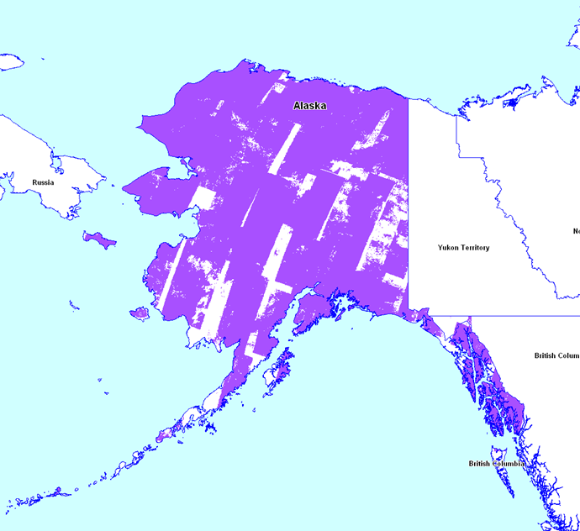
Reference3D – DTED Level 2 (DEM)
Elevation
Model
On-going, Pro-active, SPOT5 HRS Stereo Collection Campaign
Today:
83% of Alaska covered with cloud-free stereo pairs
Collection expected to be completed Summer 2009

Slide 23

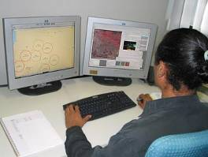
Experience with Production
Spot Image has tremendous experience producing large area ortho mosaics
Production can be completed by Spot Image or another company
Spot Image has long standing partnerships with Value Added Resellers in Alaska
  AeroMetric
  eTerra
Spot Image can support any production entity
  Software solution
  Knowledge/experience

Slide 24
Robust Production Solution is Required
You Need Seamless Ortho-Mosaic Production Capability
Block Bundle Processing
Reduced GCPs
  100 GCPs statewide
  No GCPs are needed when using Reference3D
Spot Image uses Pixel Factory to build large ortho mosaics
  Pixel Factory allows
    Semi-automated production of ortho mosaic
    Color balanced across the production block
      False and Natural Color options
    Scalable production volume
      Starting at 500,000km² per month
All COTS Image Processing Software are compliant with SPOT data

Slide 25
SPOT Proposed Solution
Control
Solution:
SPOT DRS
Solution:
GCPs
Reference3D
Imagery
Elevation
Model
Solution:
ASTER GDEM
Future NED
Reference3D
Production
Solution:
Pixel Factory
Other COTS

Slide 26
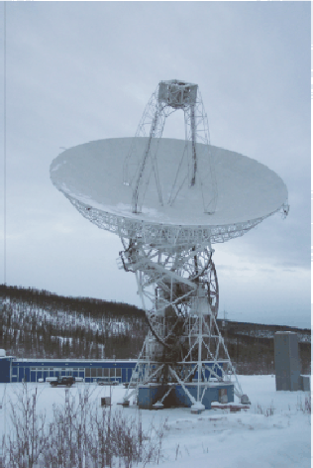
SPOT Proposed Solution
The Foundation For Future Growth and Needs …
A SPOT
Direct Receiving Station
Imagery

Slide 27
Spot Image Corporation
Spot Image Corporation
A Recognized Leader With A Long History of Success
In the Earth Observatory Industry

Slide 28
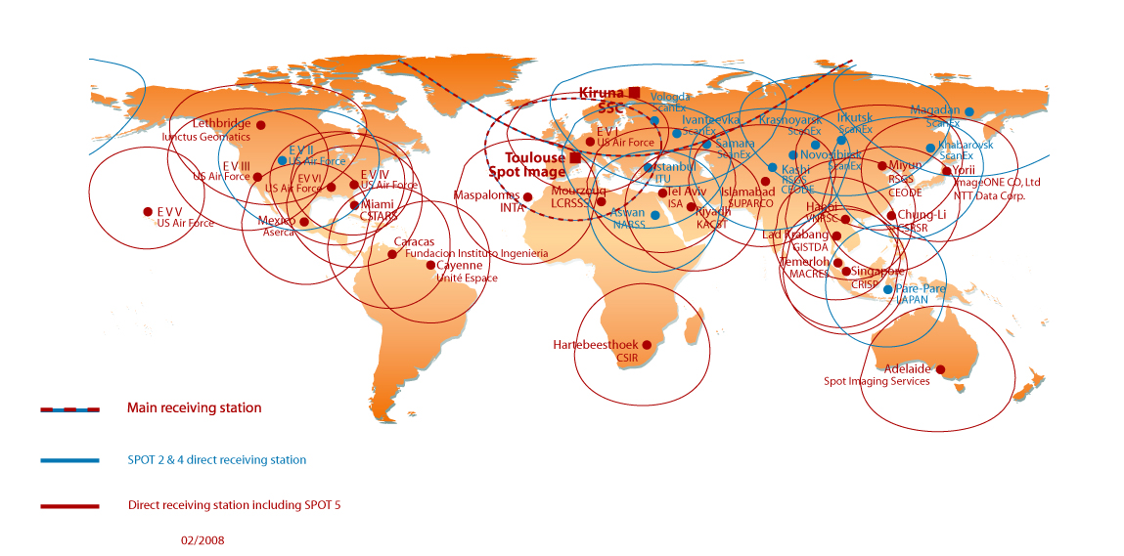
Unparalleled Direct Receiving Station Network
43 DRS: 28 are Receiving SPOT5
7 New Stations in 2008

Slide 29
Experience with Large Collections
This is what Spot Image does best
Collections over Alaska
  2007 – Collected ~2.96M km² of data
  2008 – Collected >3M km² of data
History of large collection campaigns over North America
  1999 - 2000: Complete collection of CONUS (near cloudfree)
  2003: Complete Coverage of Alberta, Canada (660,000km²)
  2004: Completely new coverage of Alberta, Canada (660,000km²)
  2005: Collected ~9M km² of 2.5m Pan data over North America with less then 10% cloud cover
  2006 & 2007: Collected ~3.2M km² of cloud free data over Canada

Slide 30
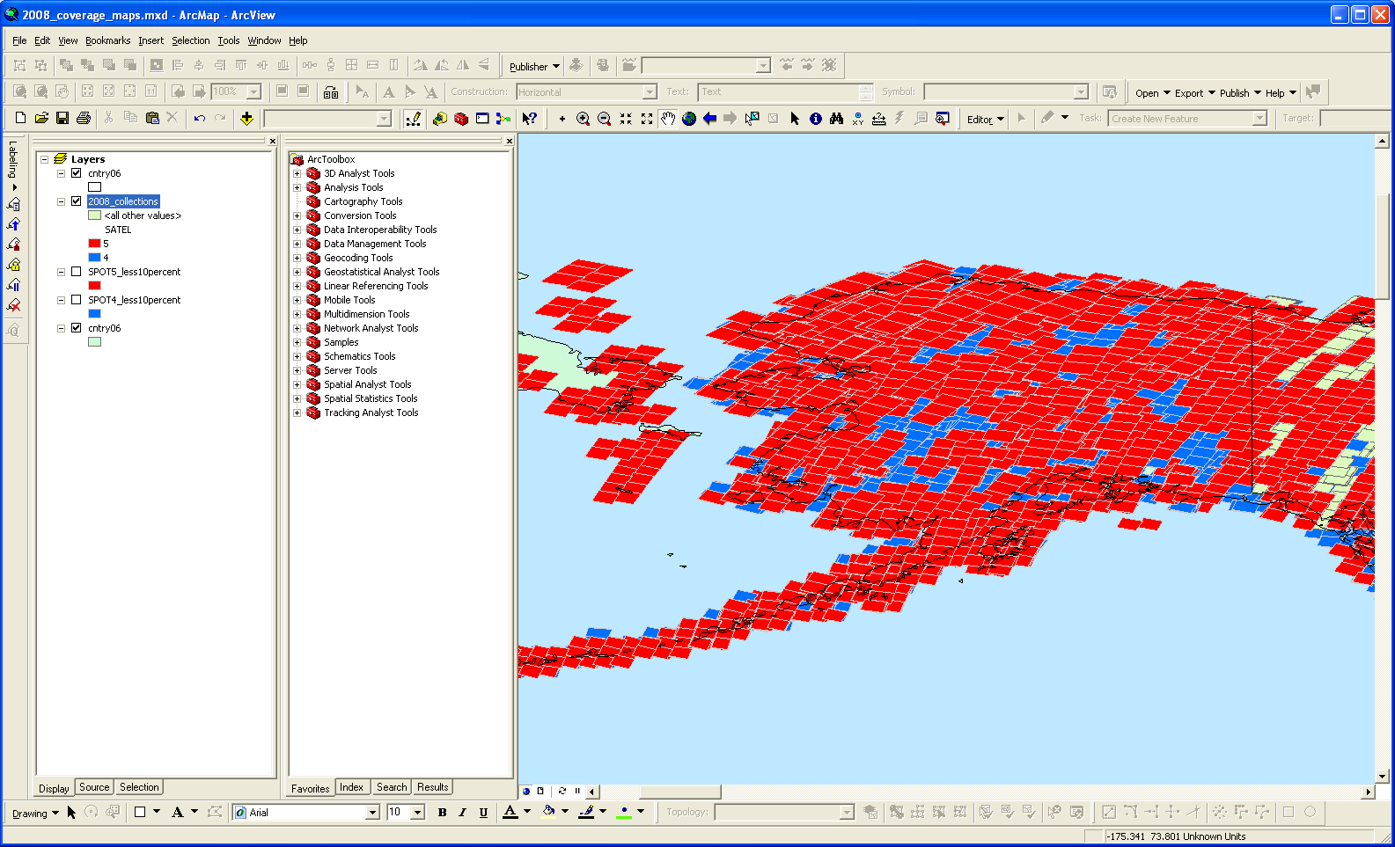
Collection over Alaska in 2008
2008 Collections
SPOT 4
SPOT 5

Slide 31
Countrywide ortho production
In 2006 Spot Image started production of the SPOTMaps
  A 2.5m natural color base map product
  Seamless natural color ortho mosaic
  Suitable for working at scales between 1:10,000 and 1:20,000
  For production Spot Image selected Pixel Factory™ for its capacity to process large numbers of images automatically
  Spot Image is capable of producing 3.5M km² of SPOTMaps per month
SPOTMaps coverage 62 countries and growing
Afghanistan (South) | Cyprus | Iraq | Mauritania | Romania | Taiwan
Algeria (North) | Czech Republic | Israel | Mexico | Serbia | Tunisia
Australia | Djibouti | Italy | Moldavia | Slovakia | Turkey
Belgium | Egypt | Jordan | Montenegro | Slovenia | Turkmenistan
Bosnia and Herzegovina | Eritrea | Kuwait | Morocco | South Africa | UAE
Botswana | France | Lebanon | Namibia | South Korea | Uzibekistan
Brazil | Gaza | Lesotho | North Korea | Spain | West Bank
Chile (North) | Greece | Libya | Oman | Sudan | Yemen
China (Beijing) | Hungary | Luxembourg | Pakistan | Swaziland | Zambia
China (Shanghai) | India | Malta | Portugal | Syria | Zimbabwe
Croatia | Iran

Slide 32
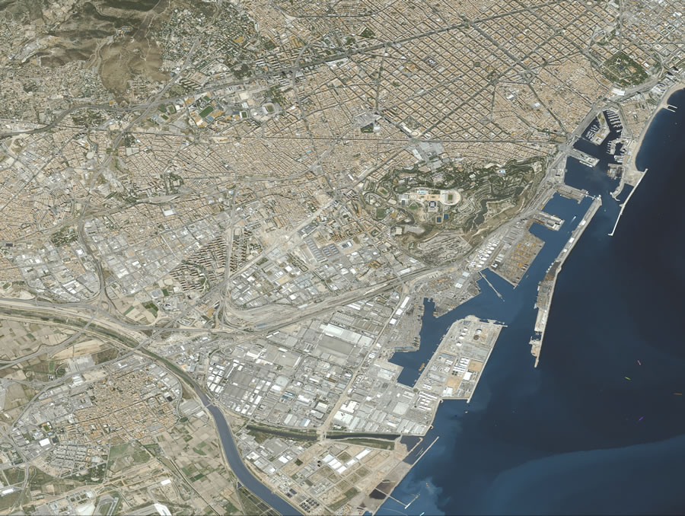
SPOTMaps
Barcelona, Spain

Slide 33
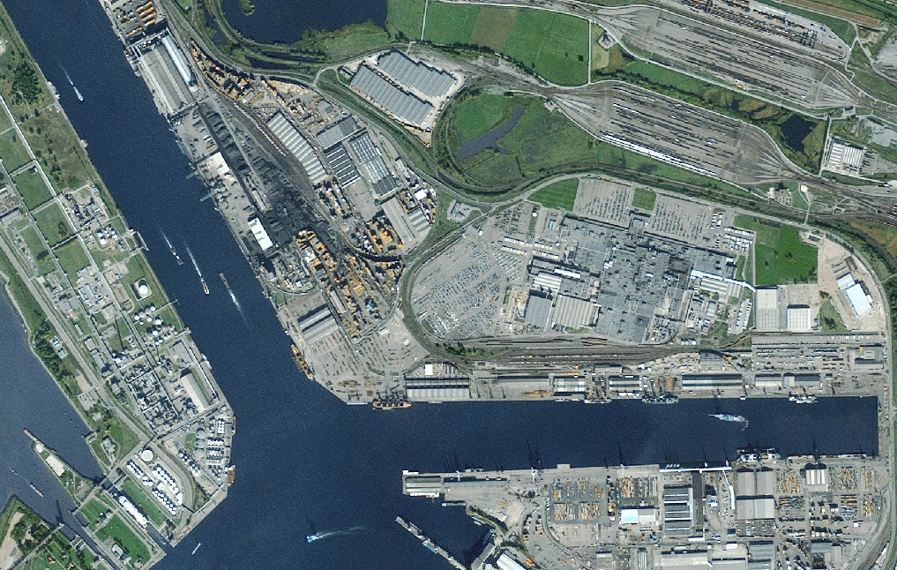
SPOTMaps
Port d’Anvers, Belgium
© CNES 2004-2007 / Spot Image

Slide 34

NGA CCAP Evaluation in 2006
Report concluded Spot 5 data accuracy
meets or exceeds vendors stated accuracy
Results - Improved horizontal accuracy
of 8.8m at CE90

Slide 35

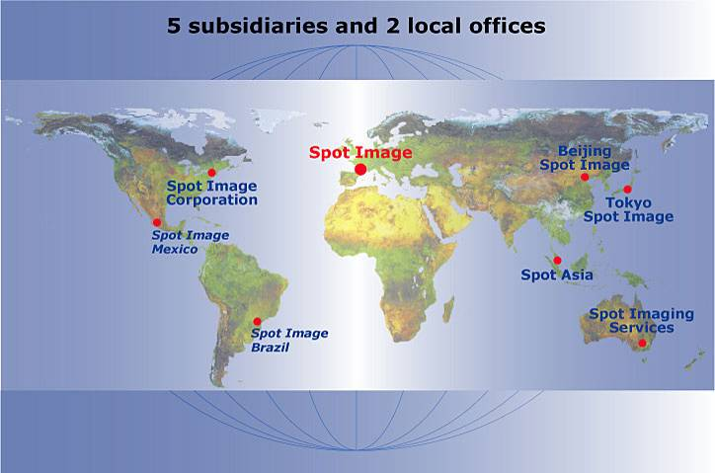
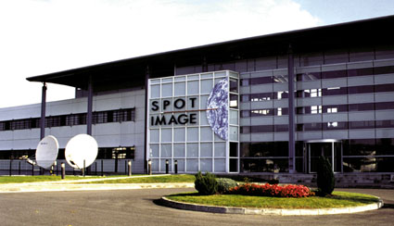
SPOT Image – Corporate Overview
Strong US presence
Increased ownership of EADS/Astrium Services (81%)
Strong Worldwide Presence
5 subsidiaries and 2 offices
3 satellites in Full Operation: Spot 2, 4 and 5
43 active direct receiving stations
Distribution rights for other satellites: TerraSAR-X, Formosat-2, Kompsat-2
SPOT5
SPOT4
SPOT2

Slide 36
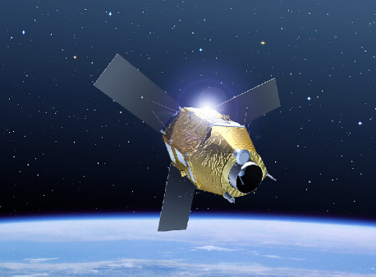
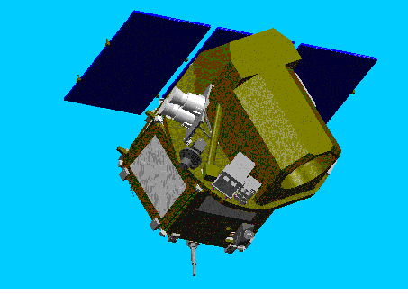
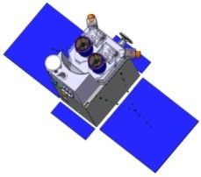
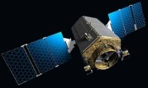
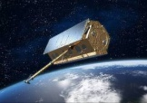
SPOT Satellite Constellation – Assured Mission Continuity
SPOT 2, 4 & 5 Satellites
SPOT 6&7
Pléiades 1 & 2
SPOT4
SPOT5
SPOT2
3 Satellites Currently in Operation
SPOT 2 & 4 10 & 20m
SPOT 5 2.5m
60km Swath
SPOT 5 Extended to 2015
Data Distribution for TerrSAR-X, Formasat-2, Kompsat-2
Extensive Worldwide Coverage
25 Years of experience
High Resolution
Large Swath
Privately Funded
2 Satellites
Data
  2m Pan
  8m XI 4-bands
  60km Swath
  Collection : 3M km2 / Day
  Stereo Capability
  Launch Date Q1 2012
Very High Resolution
Dual Program
2 Satellites
Data
  60cm Pan
  2.8m XI 4-Bands
  20km Swath
  Automatic 50cm Ortho
  Direct Tasking
  Launch Date Q1 2010

Slide 37
Summary
SPOT’s Solution is Ideally Suited to Meet ALL of the
SDMI Imagery collection requirements and mandates TODAY!
Spot Image can
Complete collection in 5 years
2.5m resolution
Meet the 1:24,000 NMAS
Additional Benefits
25 year of experience
Access to SPOT 4
Monitoring capability
Near real time delivery
Increased archive

Slide 39
Questions?

Slide 40
Thank You

