Slide 1
Overview of Alaska Mid-Accuracy DEM from Airborne IFSAR
David F. Maune, Ph.D., PSM, PS, GS, CP, CFM
Dewberry
8401 Arlington Blvd.
Fairfax, VA 22031
Tel: (703) 849-0396
Email: dmaune@dewberry.com

Slide 2
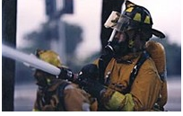
You will be drinking from Dave’s Firehose
(over 60 slides in 20 minutes)

Slide 3

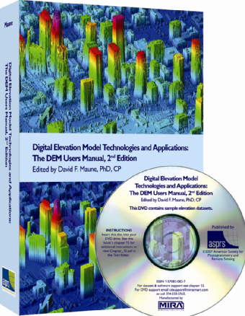
2nd Edition, 2007
Introduction to DEMs, 3-D Surface Modeling, Tides
Vertical Datums
Accuracy Standards
National Elevation Dataset
Photogrammetry
IFSAR
Topographic & Terrestrial Lidar
Airborne Lidar Bathymetry
Sonar
Enabling Technologies
DEM User Applications
DEM Quality Assessment
DEM User Requirements
Lidar Processing & Software
Sample Elevation Datasets

Slide 4
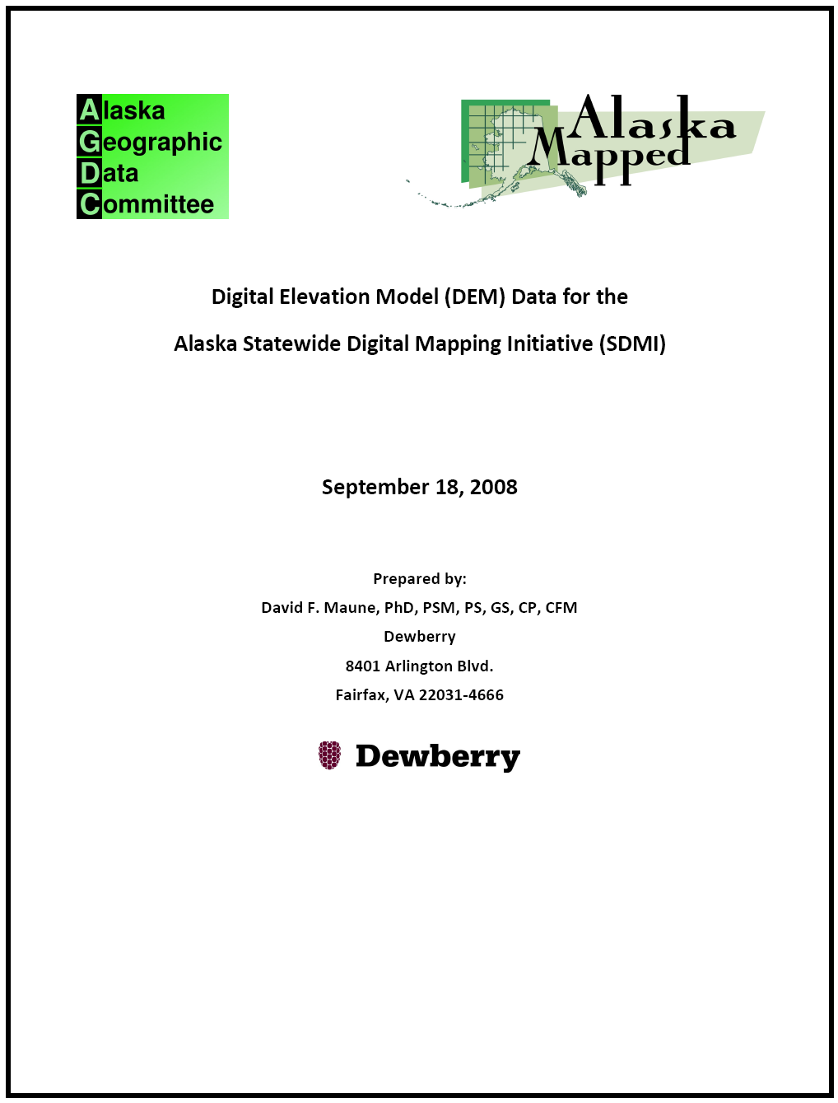
Alaska DEM Whitepaper
Alaska has never been mapped to National Map Accuracy Standards
Alaska DEMs in the National Elevation Dataset (NED) are very inaccurate/obsolete
Statewide need for DEMs (DTMs & DSMs) with vertical accuracy equivalent to 20-ft contours, based on needs for aviation safety & other user applications (e.g. orthos)
Airborne IFSAR = most cost-effective & timely solution for DEMs statewide

Slide 5
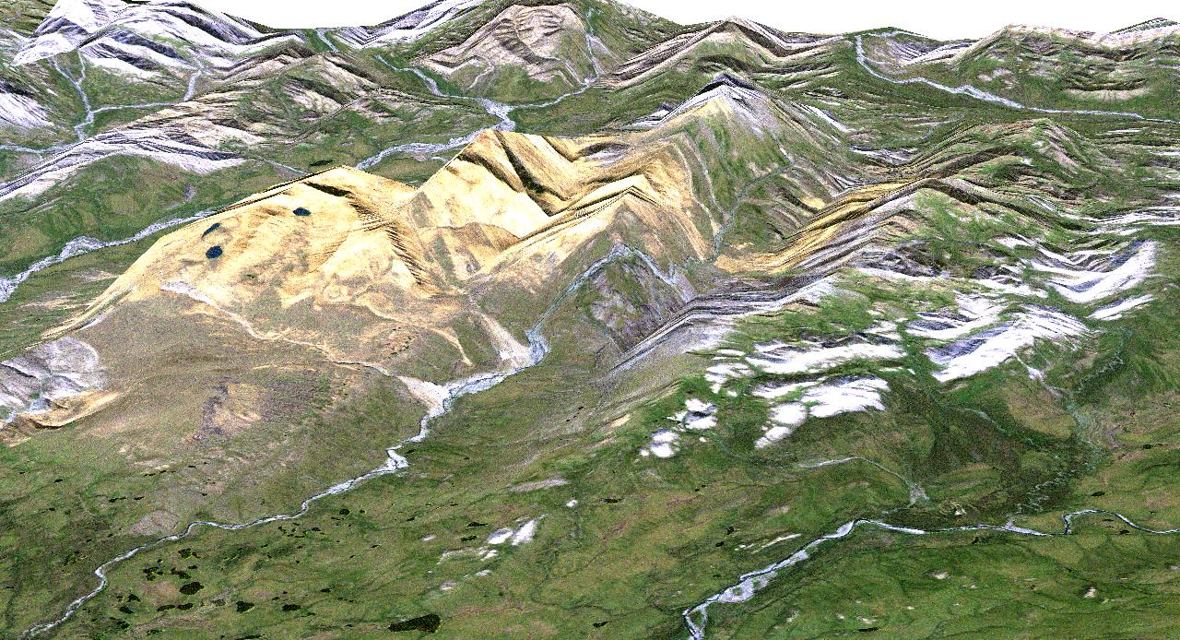
The Problem

Slide 6
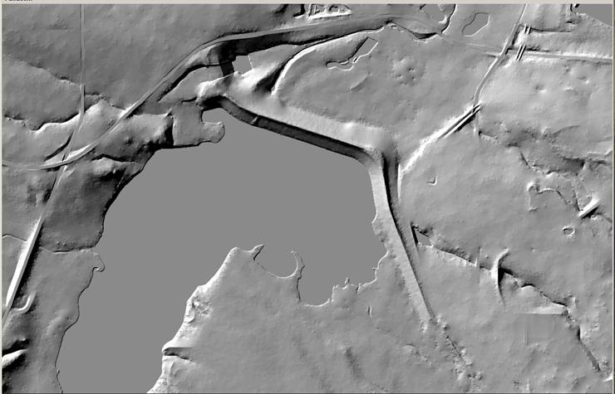
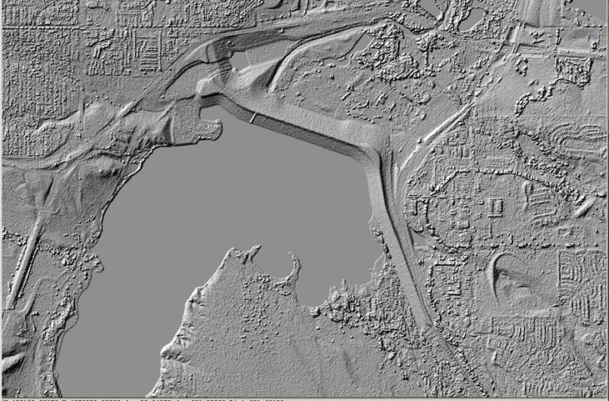
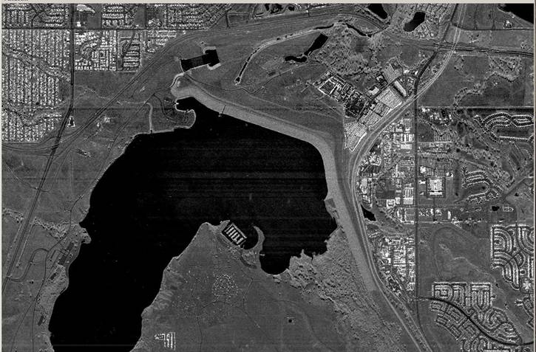
The Solution
DTM
DSM
Three normal airborne IFSAR products
Could register satellite imagery to ORI to improve positional accuracy with minimal GCPs
ORI
Notes:
IFSAR flies from relatively high altitudes, covers large areas, and is the least expensive of airborne data acquisition options for broad area coverage. It will be flown at mean lower low water (MLLW) and will show shorelines accurate to 2 meters. This technique has had third-party verification & validation by USACE, USGS, USDA, NASA, NGA, and numerous organizations in Germany and the UK. However, IFSAR will not be used to generate bare-earth DEMs (DTMs) for Louisiana because the existing Lidar DEMs are more accurate.
IFSAR generates a geocoded, orthorectified image that is capable of accurately geolocating structures and other cultural features. It is a rapid mapping system (cloud, fog & haze penetration), day/night acquisition, and guaranteed data acquisition at tide-coordinated times. Some states and countries use the ortho-rectified radar image (ORI) for ortho-rectification of other high resolution airborne and satellite optical imagery.
Another major advantage of IFSAR is that there is only one temporal epoch, not several epochs as is common with low-flying aircraft. Therefore, there is minimum cultural change during acquisition. The entire project area will have identical sensor accuracy, identical data processing techniques, and identical data form and format. ORI is also valuable for extraction of GIS vector data, especially since it is the least expensive per square mile and can be acquired annually or periodically at other time intervals.

Slide 7
Consensus points from NDOP & NDEP
We have no time to waste
We must remain true to Alaska’s requirements
We must find timely, cost-effective solution
ICAO Area 1 Requirements: 11/20/2008
ICAO Area 2 Requirements: 11/20/2010
Other statewide user requirements: Immediate
Alaska’s mapping needs have been neglected for 50 years; unmet needs in Alaska are dire, especially aviation safety
Only airborne mapping options can satisfy AK’s technical and accuracy requirements
Airborne IFSAR costs are significantly less than airborne LiDAR or photogrammetry
Multiple contracting options are available to obtain the most cost-effective solution for timely delivery of quality products
20’ contour accuracy or better
Need both federal and state funding
Both DSM and DTM, especially mountain peaks, ridgelines and hydrology
Technology that overcomes adverse weather conditions
Technology that maps snow-capped mountains & glaciers
Technology that is cost-effective

Slide 8
2010 USGS Task Orders
ORIs with ≤5-meter pixels; 1:24,000-scale horizontal accuracy
DSMs and DTMs with 5-meter posts; DTM vertical accuracy:
  LE90 = 3m for 0-10°, 6m for 10-20°, 9m for 20-30°, 12m for >30° slopes
Independent accuracy testing, within reasonable costs
Alaska Albers projection, orthometric heights, for the NED (geographic coordinates)
Resampled 30’ x 30’ quarter cells (4 per 1-degree cell)
15’ x 15’ tiles (16 tiles per 1-degree cell)
Second format (HRTe3) for NGA
FGDC compliant metadata (3 formats)
For $ available, maximize 1-degree cells based on government priorities; initial goal was for ≥20 cells
Ellipsoid height option subsequently requested
Intense “coopetition” between Fugro and Intermap

Slide 9
Fugro’s Value Added Products
Value added products available at additional costing as requested include:
P-Band and derived data products
Bio-mass evaluation, studies and estimating
Ice and glacier penetration and associated DEM data development
Derived mapping products specifically designed for the Oil & Gas industry
Sea ice studies
Development of the new 1:24,000 USGS topographic maps utilizing synthetic stereo technology
Semi and automated land cover mapping utilizing FugroMAP technology
Data fusion – pan sharpened products utilizing satellite or airborne multi-spectral, hyperspectral imagery
Fully polarmetric derived data products.
Other pure P-Band products NOT part of Fugro’s previous deliverables continue to be available only as value added products at an additional cost.

Slide 10
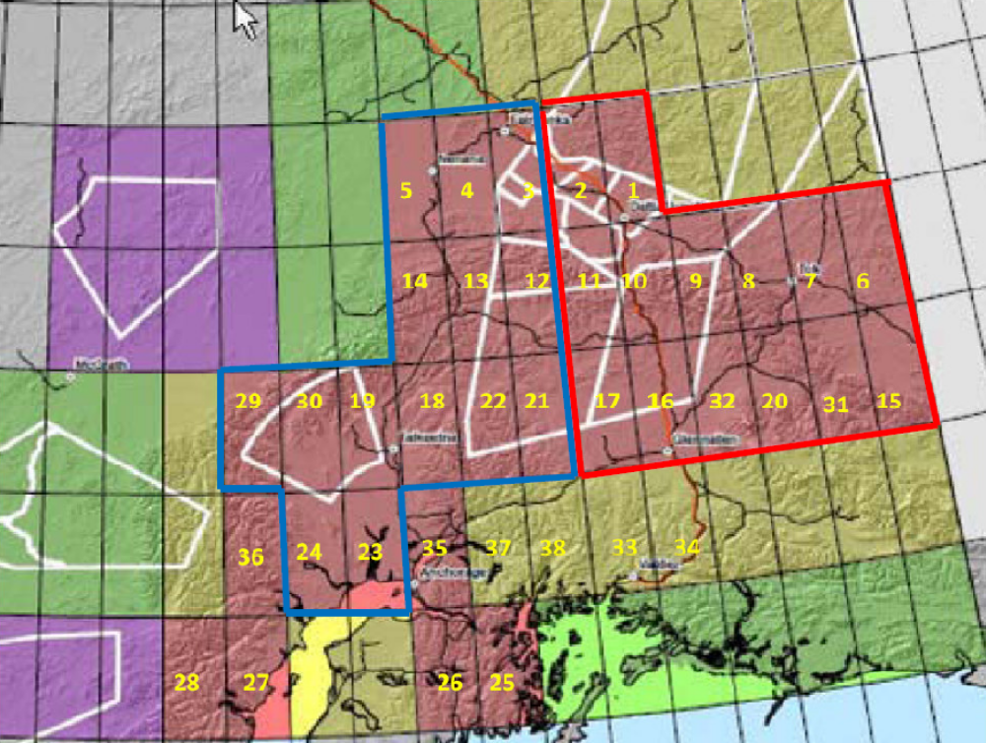
Yellow numbers are priorities provided to Dewberry
Pilot cells
Intermap Cells
Fugro Cells
147th meridian

Slide 11
NGA’s HRTE3 Specifications
1. Definitions
a. HRTE3 is defined as a Digital Elevation Model (DEM) built to the following specifications:
i. Post Spacing: 0.4 x 0.8 arc/sec (at latitudes above 50 degrees)
ii. Format: signed 16 bit GeoTIFF (whole integer, elevations in meters) with null value set to –32767.
iii. Projection: Geographic (decimal degrees)
iv. Datum:
1. Horizontal- WGS-84
2. Vertical- EGM-96 (geoid)
v. Work Unit (cell size): 30min. X 30min. (4501 rows by 4501 columns)
vi. Surface type:
1. Reflective- terrain matrix representing the physical surface of the stereo model where buildings, vegetation, etc. are portrayed.
2. Bare Earth- terrain matrix representing the earth’s surface where cultural features and vegetation are not portrayed. However, man-made earthen features such as levees, earthen bunkers and berms are portrayed in this surface type.

Slide 12
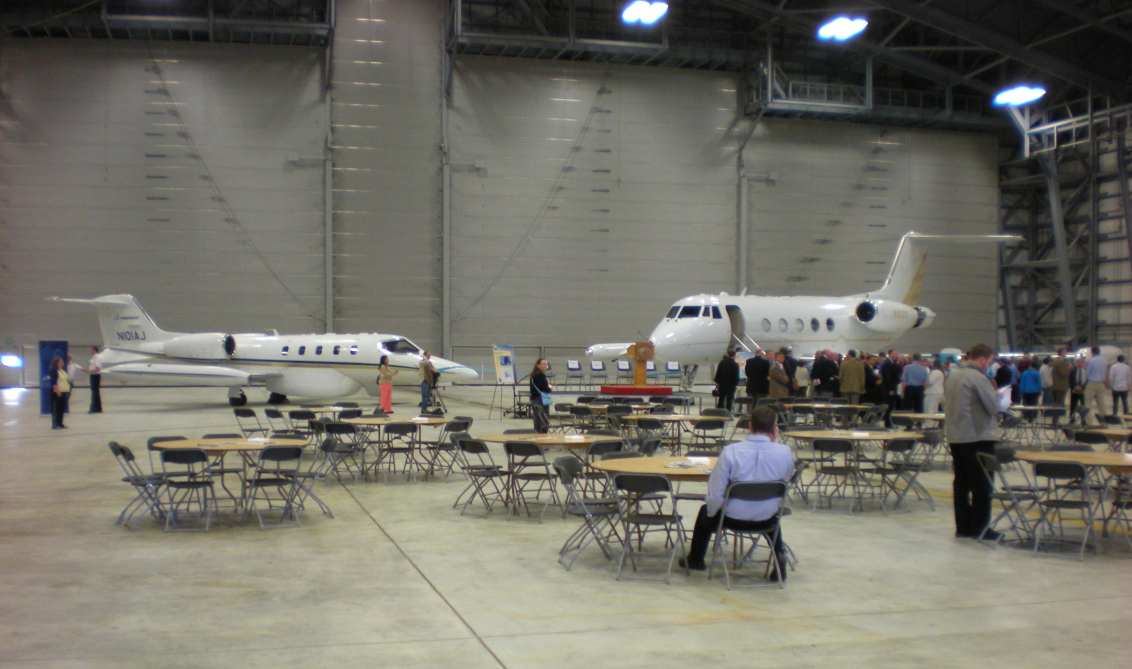
Skybreaking ceremony, 7/23/2010
Intermap’s STAR
Fugro’s GeoSAR

Slide 13
JOA Surveys, QA/QC Checkpoints
105 Datasheets with 119 QC coordinates & heights
69 towers at 53 sites
11 buildings at tower sites
Within ±250 meters of the 147th meridian:
  14 points in forested areas
  7 points on high, open terrain
18 NGS stations in Denali Highway areas

Slide 14
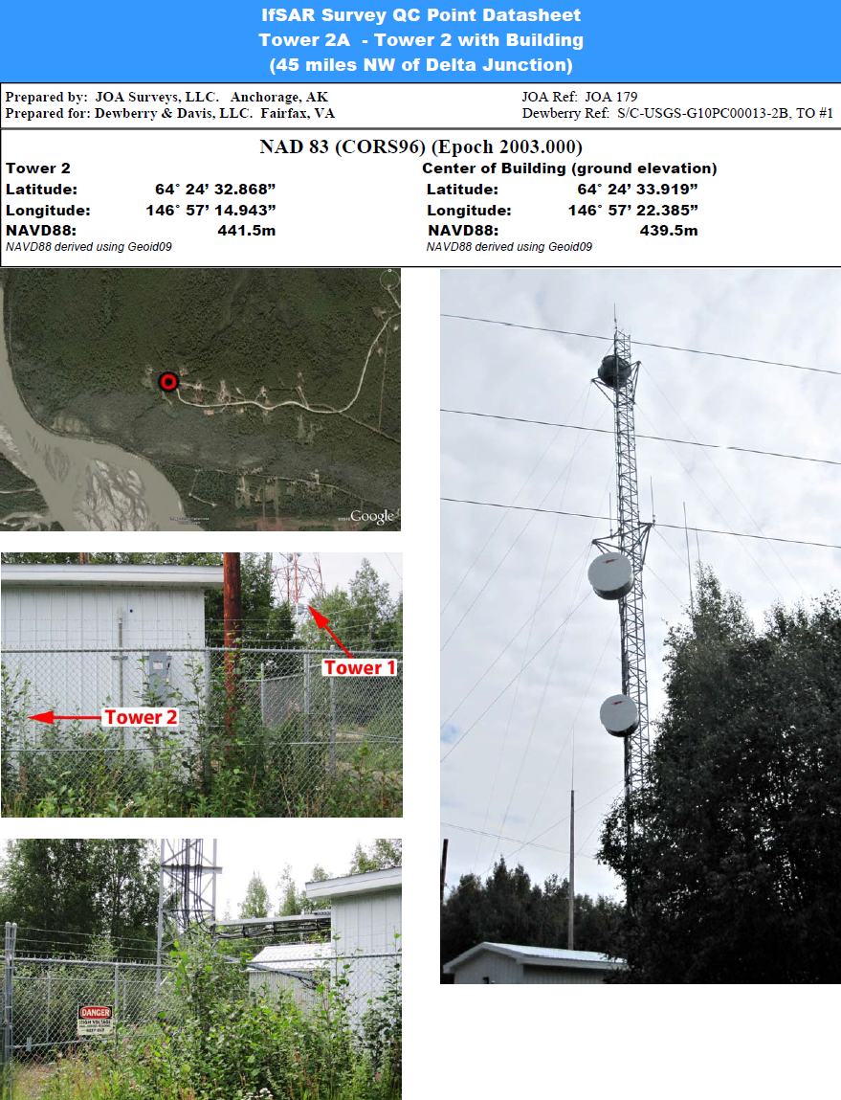
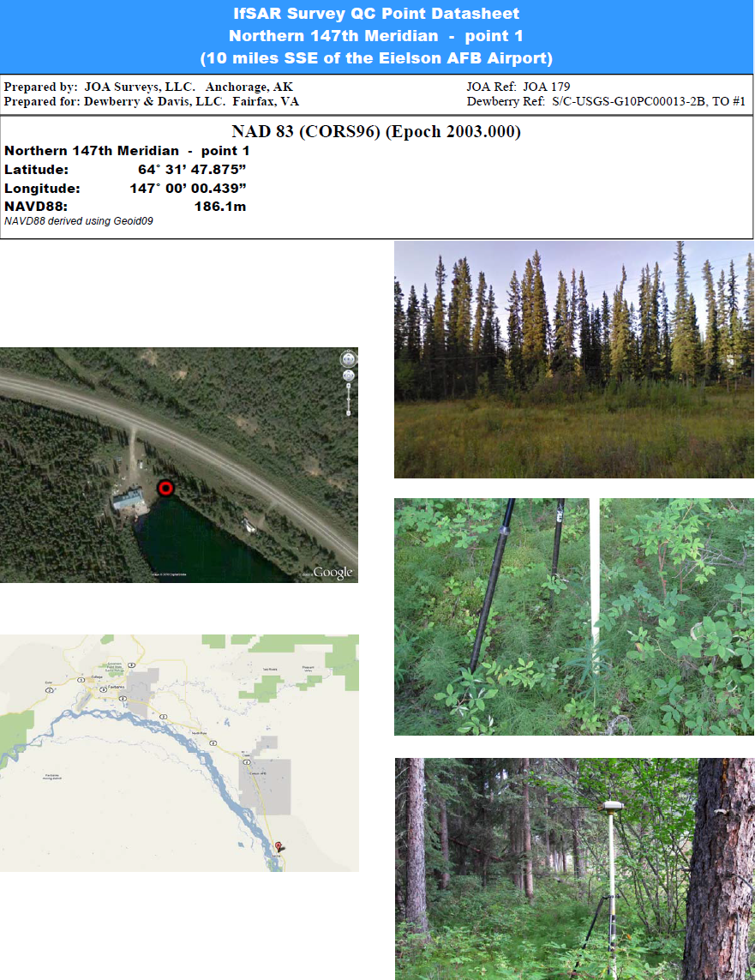
Selection of QA/QC Checkpoint Locations
Tower sites for horizontal QA
Ground points for vertical QA
Others are near 147th meridian for testing both Intermap & Fugro (buffers)

Slide 15
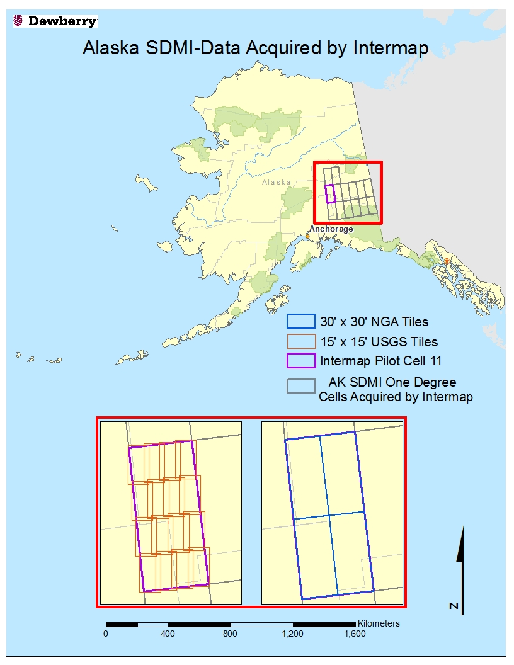
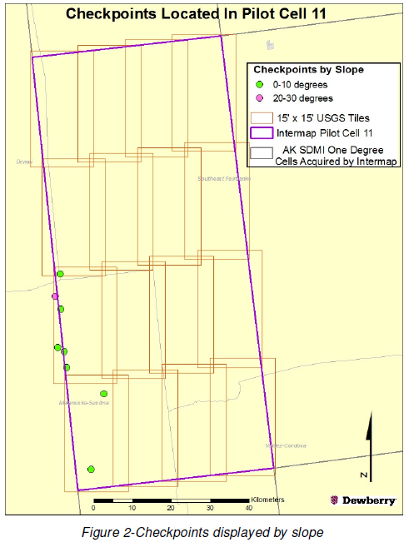
Intermap’s Pilot Cell #11

Slide 16
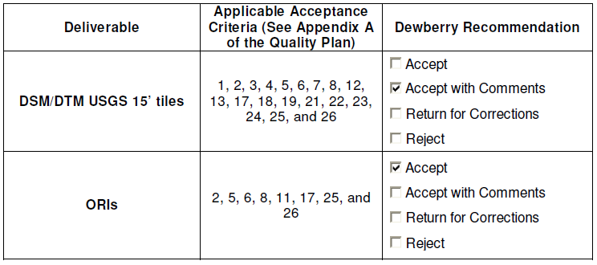
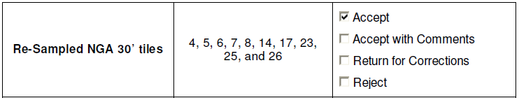
Pilot Cell #11, QA/QC Report Summary

Slide 17
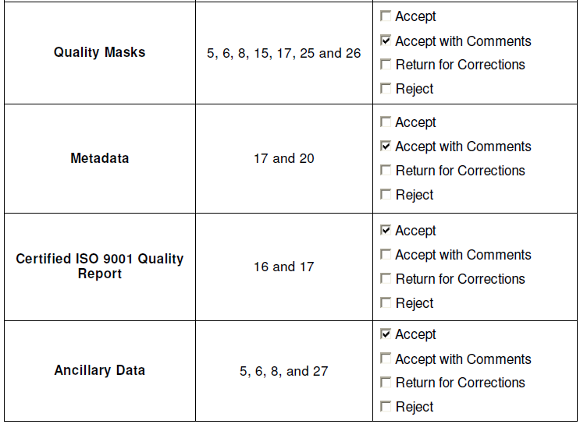
Pilot Cell #11, QA/QC Report Summary
This tile was tested & accepted by both Dewberry and USGS for the NED

Slide 18
Fugro’s Pilot Cell #12
Delivery #1 was rejected by Dewberry. We reported most DTM areas as being about 4 meters too low, but much lower at several QA/QC checkpoints:
Fugro had relied on its Profiler LiDAR data that had been processed in WGS84 (G1150) used by NGA worldwide, rather than WGS84 used nationwide in the U.S.
Delivery #2 was much better, but we still had outliers at three QA/QC checkpoints being low by >5 meters:
Fugro had applied an incorrect LiDAR bias and was getting P-band ice penetration. Fugro is now performing smart merging of P and X bands and developed a “Hydrid DTM workflow”
Delivery #3 passed Dewberry’s accuracy tests for DTM patches provided by Fugro in vicinity of checkpoints; full cell not yet delivered

Slide 19
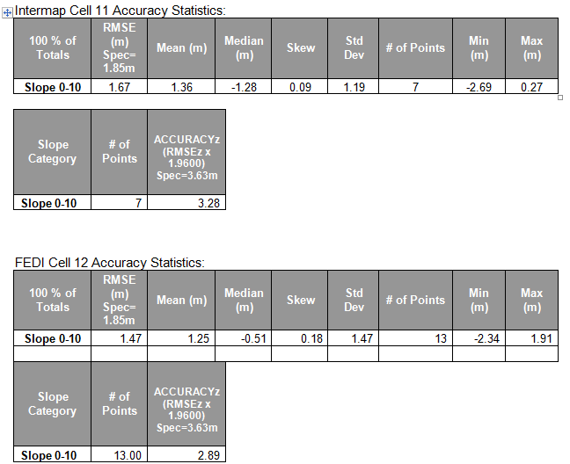
Accuracy Comparisons between Pilot Cells
Intermap passed with Delivery #1
Fugro passed with Delivery #3

Slide 20
Common Checkpoints along 147th Meridian
Checkpoint # and slope range | JOA’s Heights | Intermap’s Heights | Fugro’s Heights
12 (0-10°) | 1,644.41 | 1,642.60 | 1,640.14
61 (0-10°) | 1,527.52 | 1,526.24 | 1,527.71
64 (0-10°) | 1,699.23 | 1,699,31 | 1,700.97
66 (0-10°) | 1,462.54 | 1,461.73 | 1,460.15
63 (10-20°) | 1,641.60 | 1,638.99 | 1,614.31
8 (20-30°) | 1,771.48 | 1,767.26 | 1,758.95
Have not yet received Fugro’s hybrid DTM for two common checkpoints (#63 and #8) on steeper slopes

Slide 21
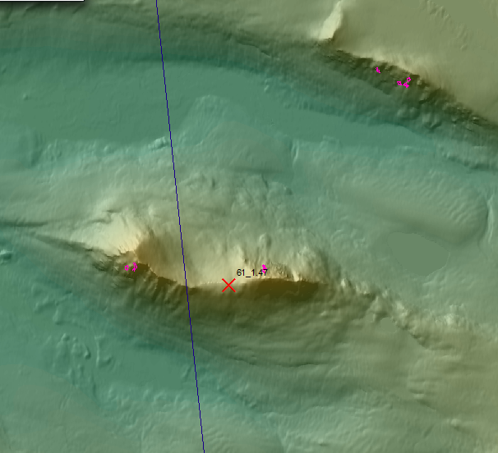
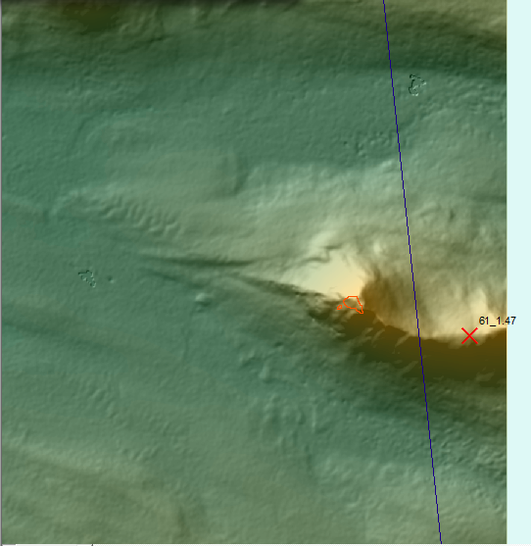
Although flat (0-10°), checkpoint at top of ridge; note void areas filled by interpolation
Intermap’s void area shown in pink
Fugro’s void area shown in orange

Slide 22
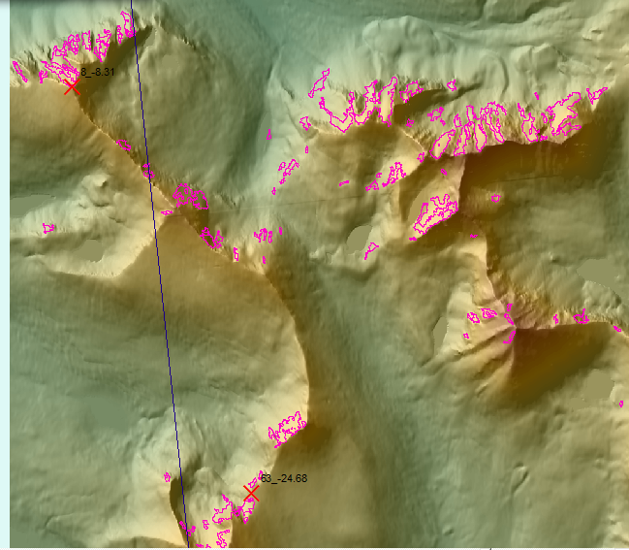
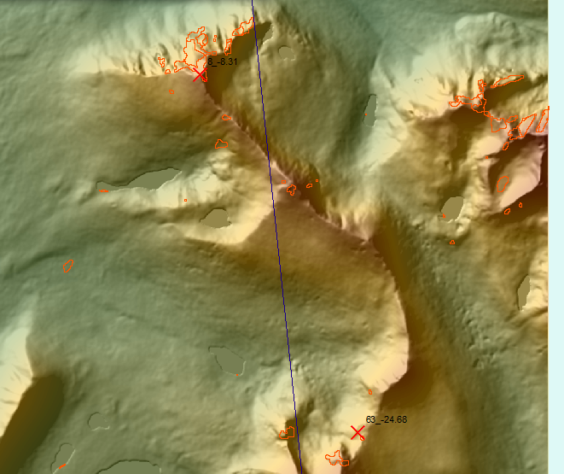
For pilot cells, worst void areas are near checkpoints #8 and #63
Intermap’s voids in pink
Fugro’s voids in orange
Intermap’s total void area for cell #11 is <1.3%; maximum allowed per cell is 5%

Slide 23
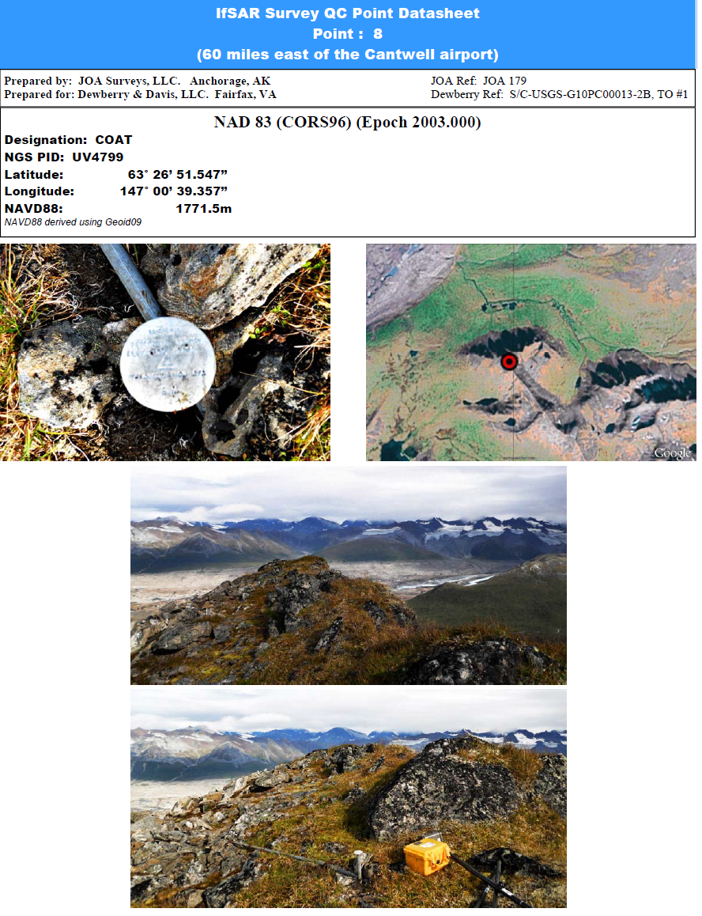
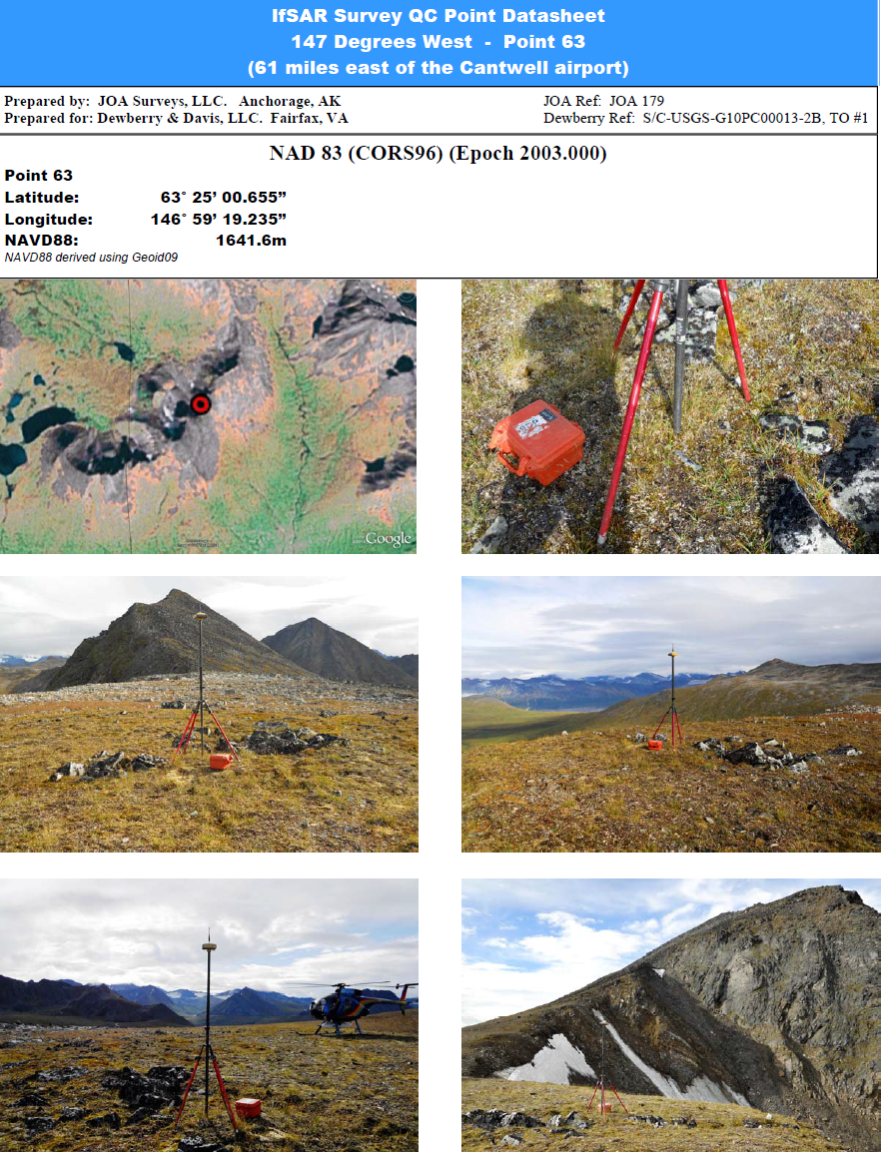
Where largest voids occur for both
Point 8 (20-30° slope)
Point 63 (10-20°) slope

Slide 24
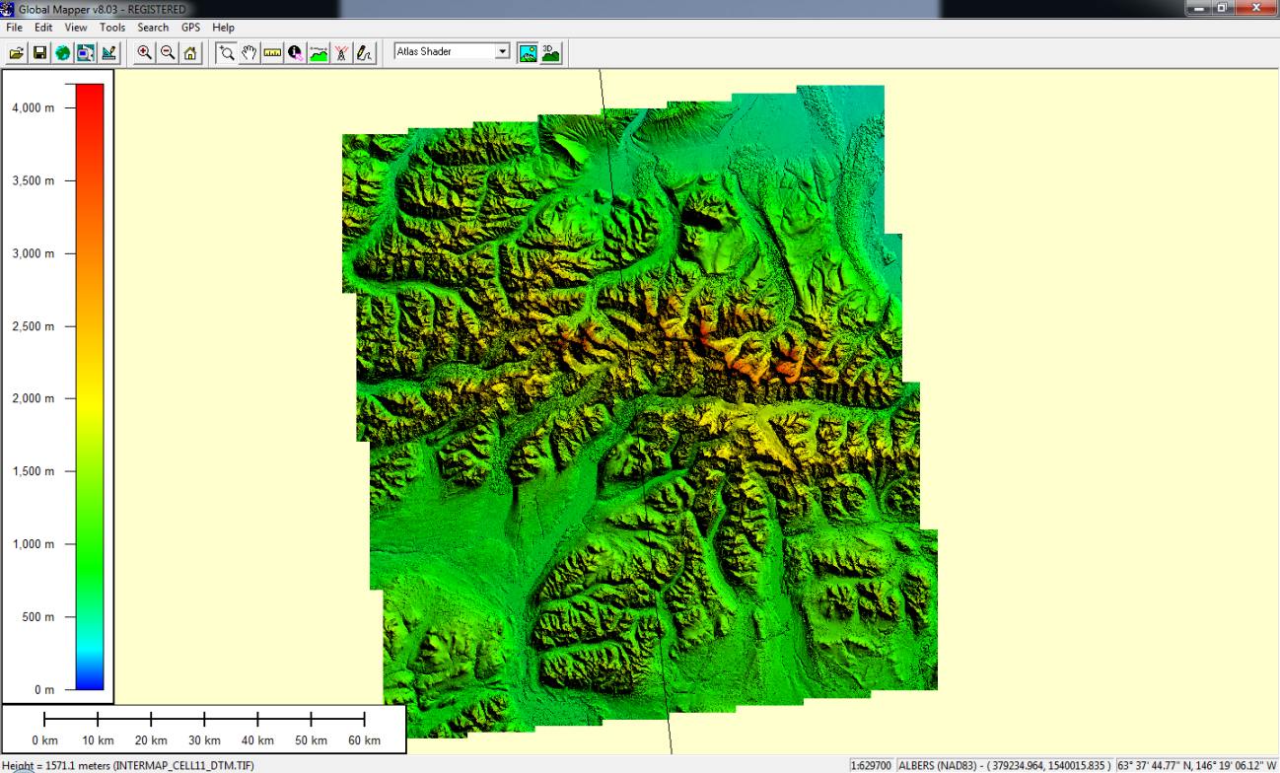
From small-scale view, Fugro’s DTM (left) joins well with Intermap’s DTM (right)
Dewberry reported that Fugro’s DTM is lower than Intermap’s in areas of ice and glaciers

Slide 25
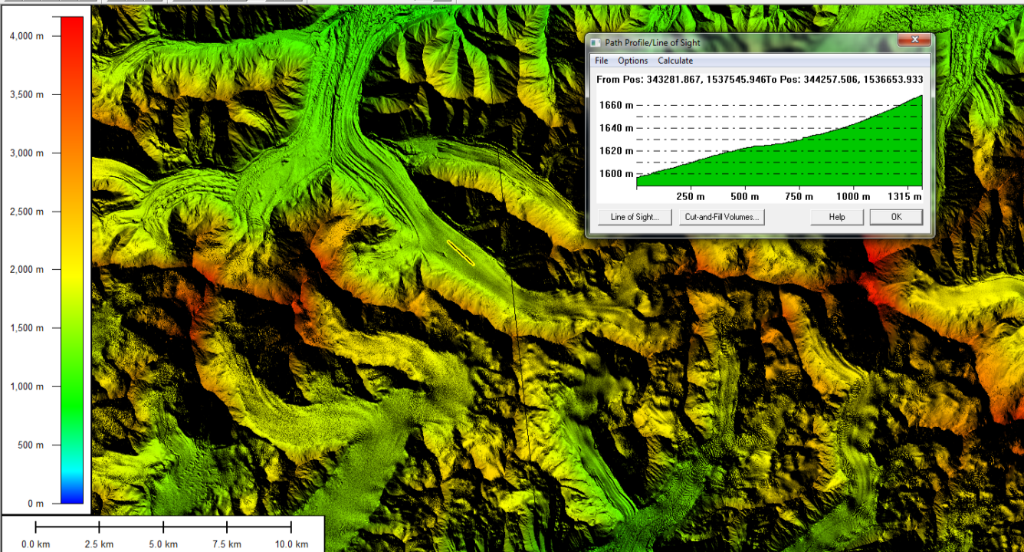
Fugro DSM (left), Intermap DSM (right); no step across seamline

Slide 26
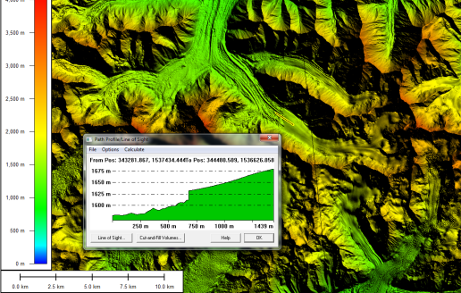
Fugro #2 DTM (left), Intermap DTM (right); major step of ~ 25 meters across seamline
Fugro determined P-band was penetrating ice; developed hybrid X-band/P-band DTM for delivery #3

Slide 27
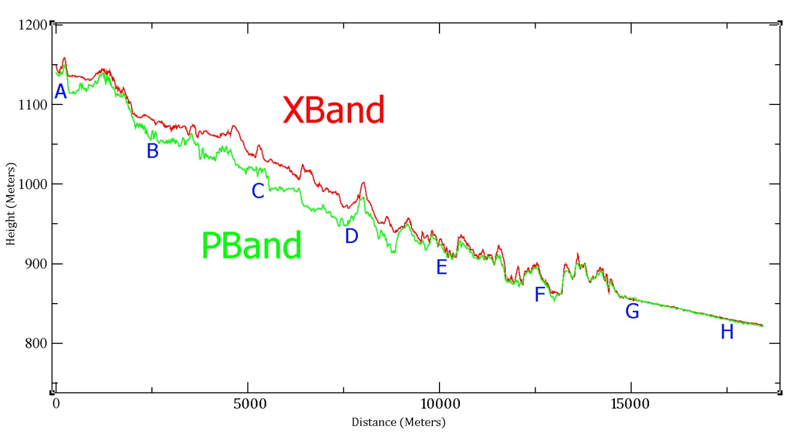
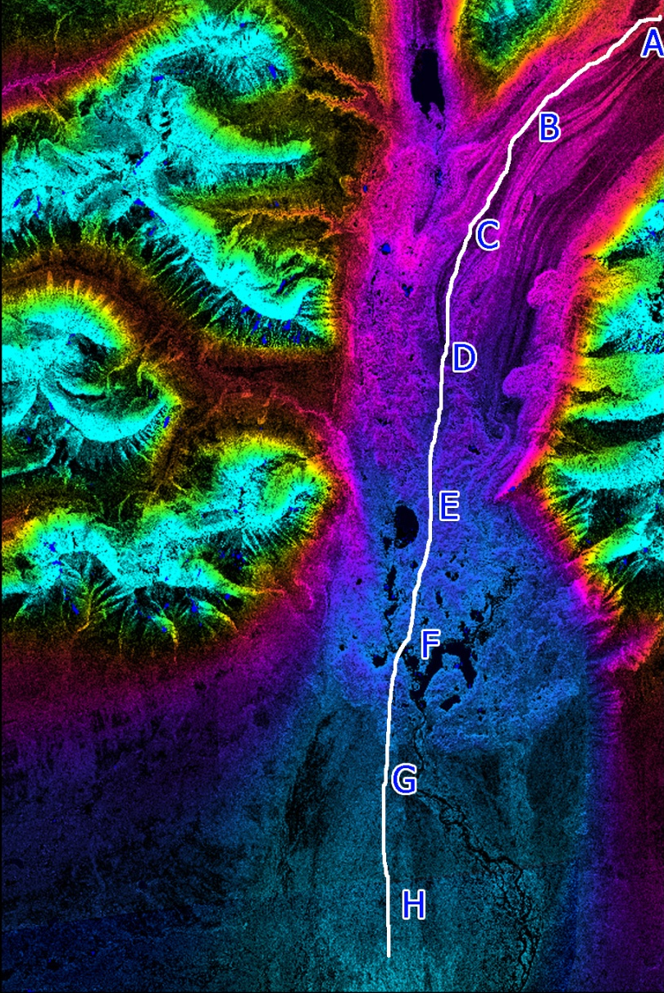
Fugro’s investigation: P-band Ice Penetration
Profile of the glacier illustrating that the P-band surface is below X-band which means it is penetrating the ice and/or snow and giving us a view of what is below the current terrain surface, be it temporary ice/snow or permanent ice/snow
This is valuable information, but it does not depict the DTM required by the task order
February 11, 2011

Slide 28
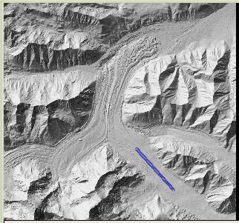
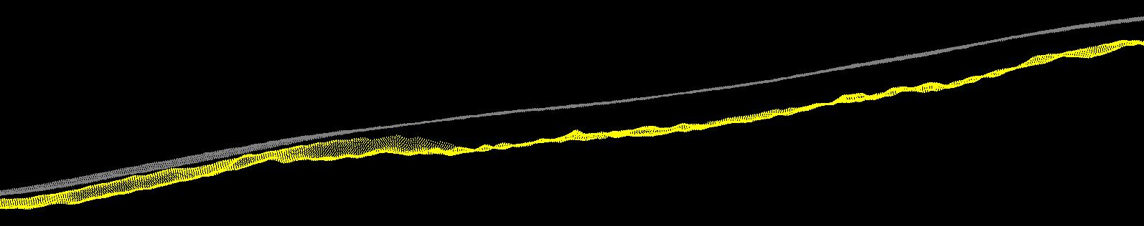
Ice Penetration
Fugro then developed a new workflow that I refer to as their “hybrid DTM,” resulting from rules-based comparisons between X-band and P-band IFSAR
Area
~30m
~25m
DSM / DTM Profile
February 11, 2011

Slide 29
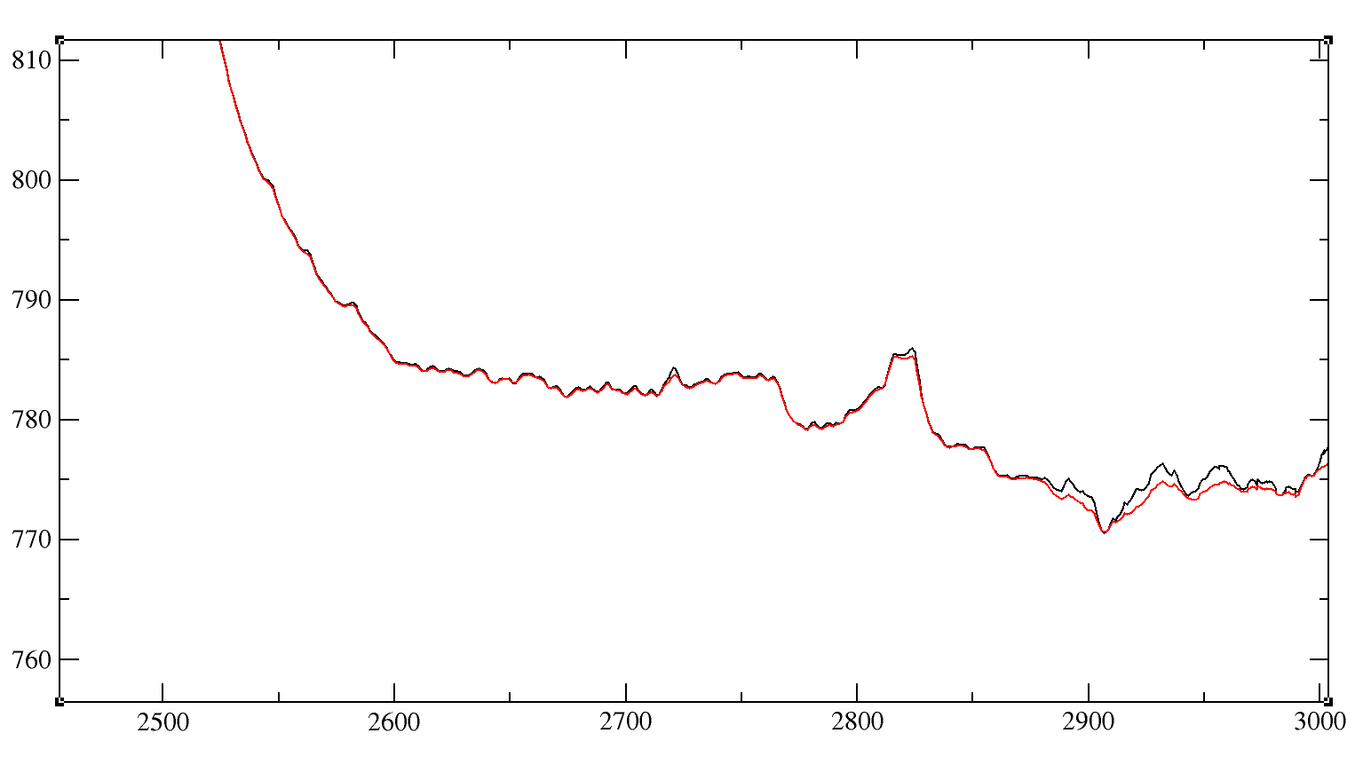
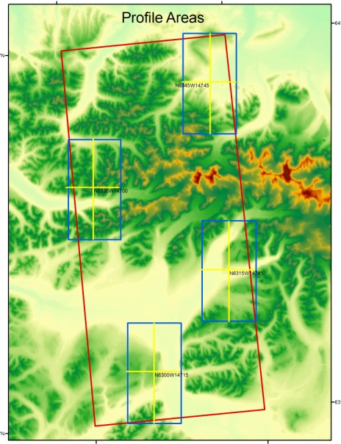
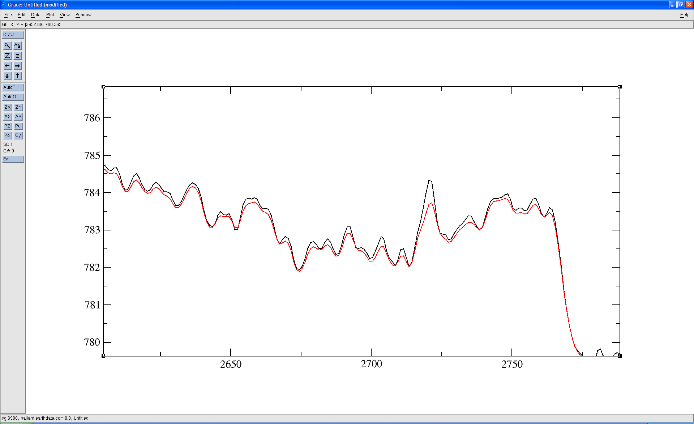
DSM / DTM New Profile Comparison
Tile N6345W14745

Slide 30
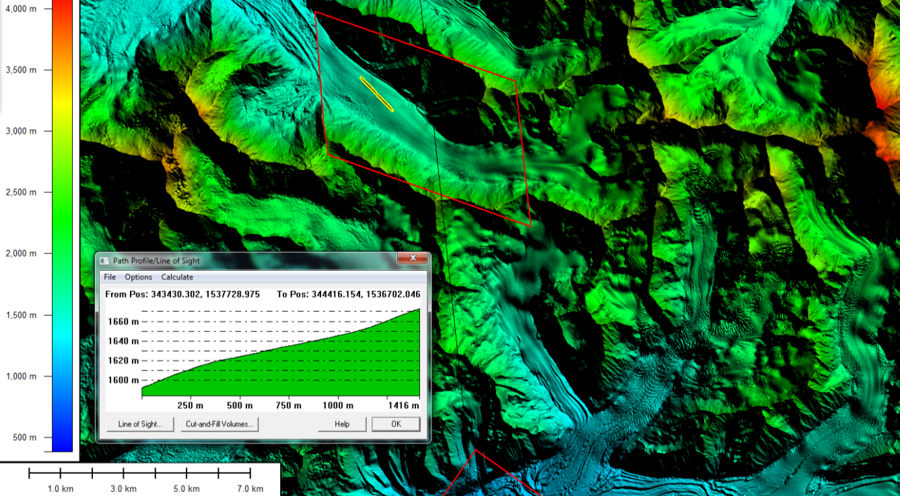
Fugro #3 DTM (left), Intermap DTM (right); now smooth transition with hybrid DTM
Delivery #3 not yet complete; the red polygon shows a limited area where Dewberry tested hybrid DTM

Slide 31
With Fugro’s initial P-band, are we seeing the geomorphology 25 meters beneath glaciers?

Slide 32
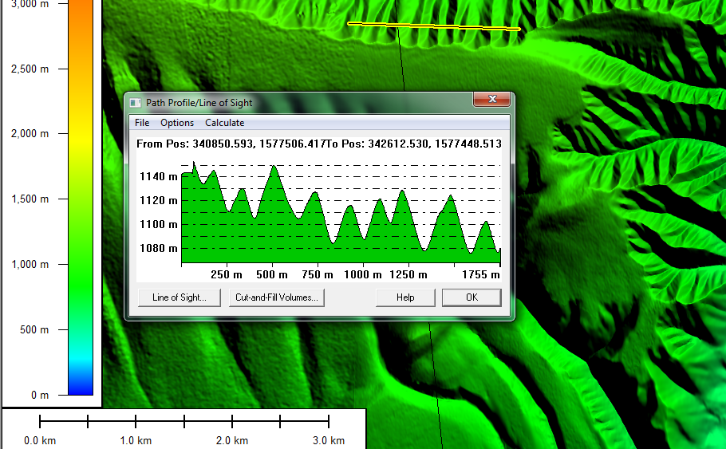
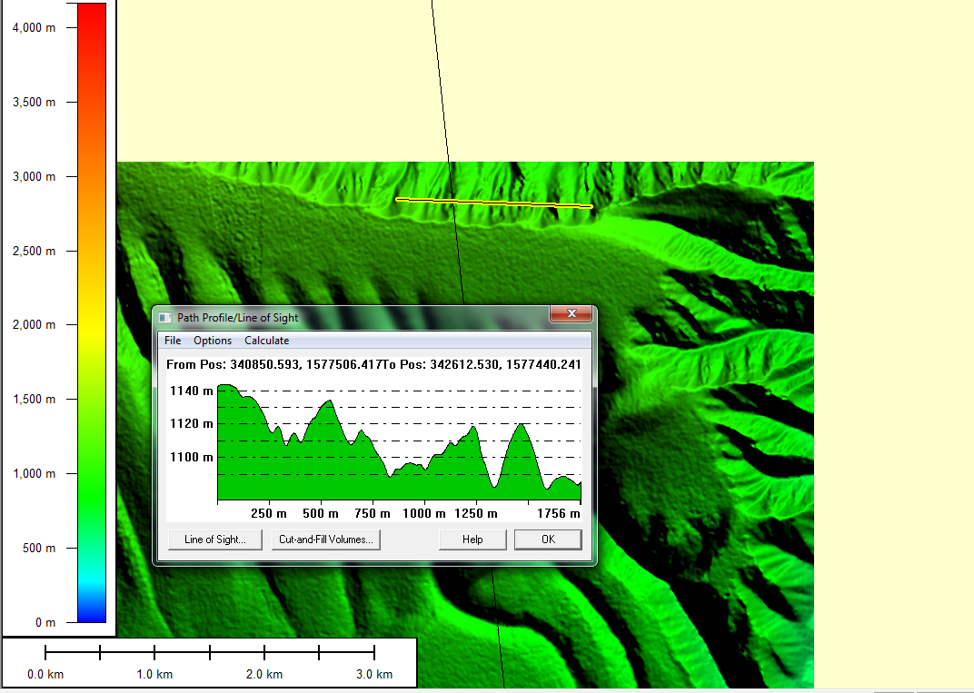
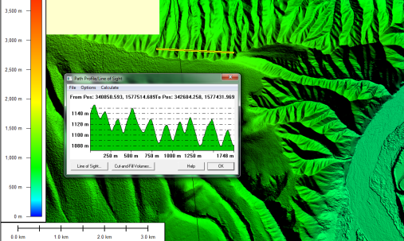
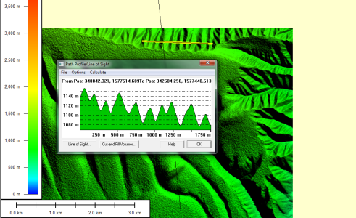
Comparison of X-band and P-band with initial Fugro Delivery #2
Intermap’s DTM (X-band)
Fugro’s DTM (P-band)
Cross section
Intermap’s DSM (X-band)
Fugro’s DSM (X-band)

Slide 33
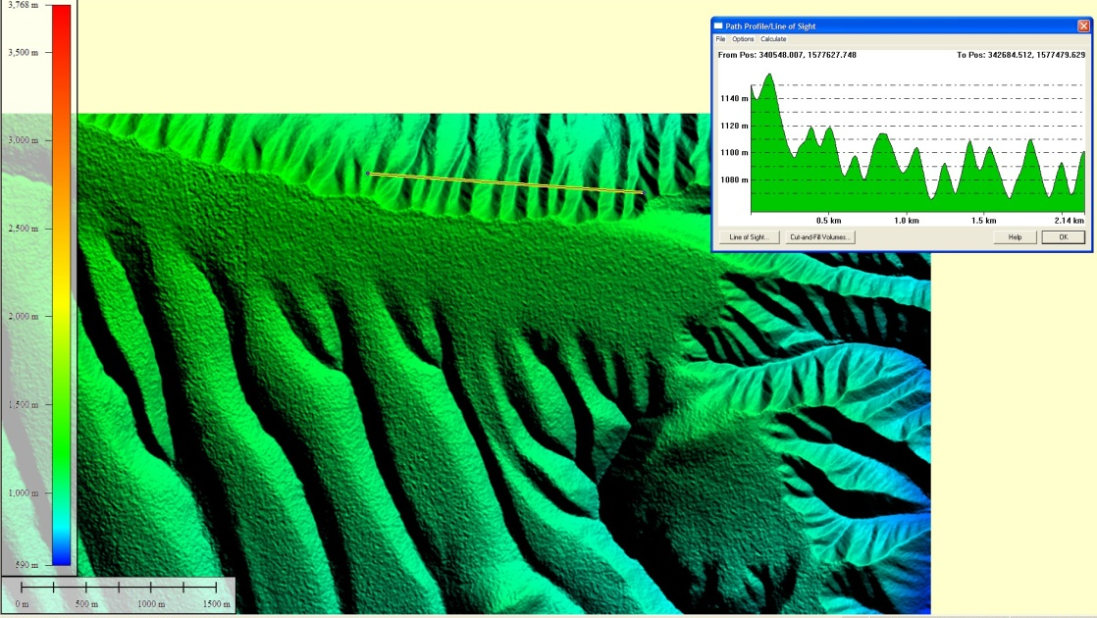

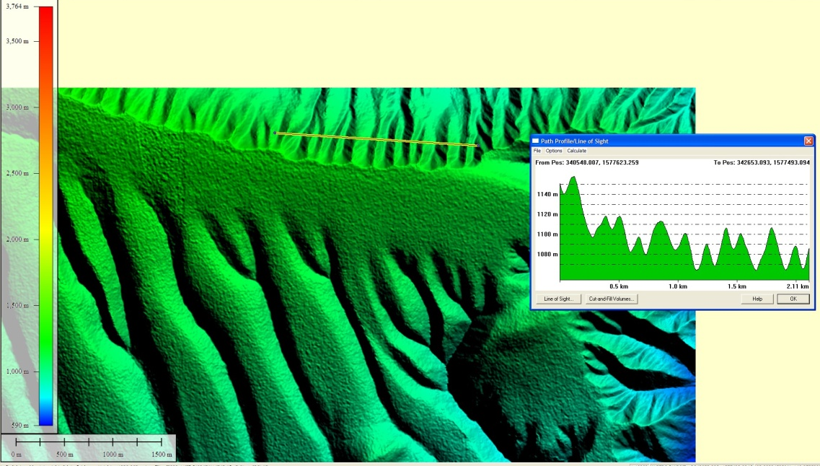

DSM / DTM New Profile with Fugro’s hybrid DTM Delivery #3
DSM
DTM
February 11, 2011

Slide 34
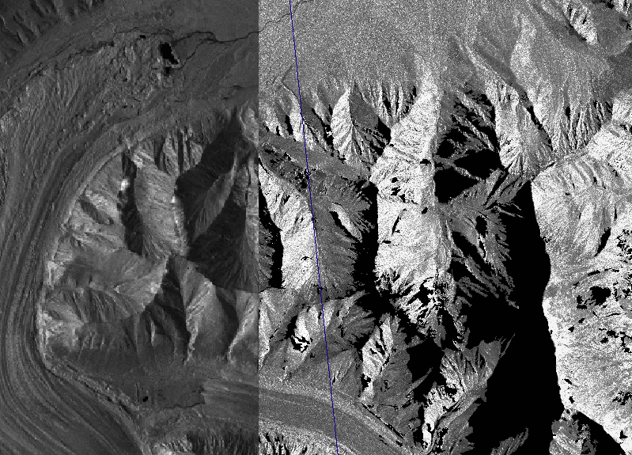
Fugro’s ORI (left) and Intermap’s ORI (right)

Slide 35
Hydrologic Enforcement of DTMs
“Enforcement parameters that exceed the following requirements are acceptable but not required:”
Lakes: length greater than 150 m and width greater than 50m will be portrayed at a constant elevation at least one meter below surrounding terrain
Double-line drains (DLD): width greater than 50m extending 150m or more in length will be collected as flat surfaces at least one meter below surrounding terrain and shall be monotonic. DLD’s that narrow to less than 50m for an extent of 300m in length shall still be depicted as the same DLD to avoid sausage link type portrayal. If the DLD width narrows to less than 30m it should be ended regardless of the 300m length criteria.
Added provisions for coastal waters, shorelines, breakwaters, islands

Slide 36
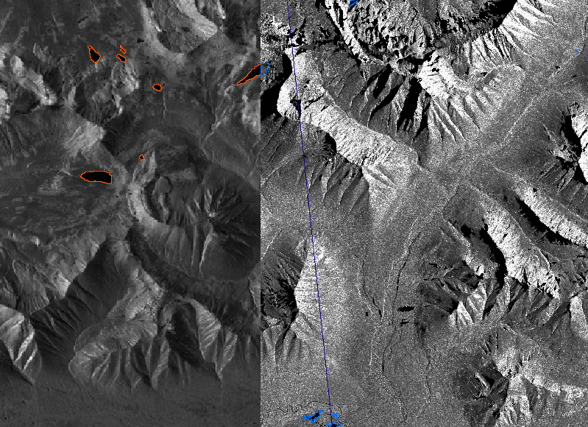
Fugro’s hydro masks (orange) on left; Intermap’s hydro masks (blue) on right

Slide 37
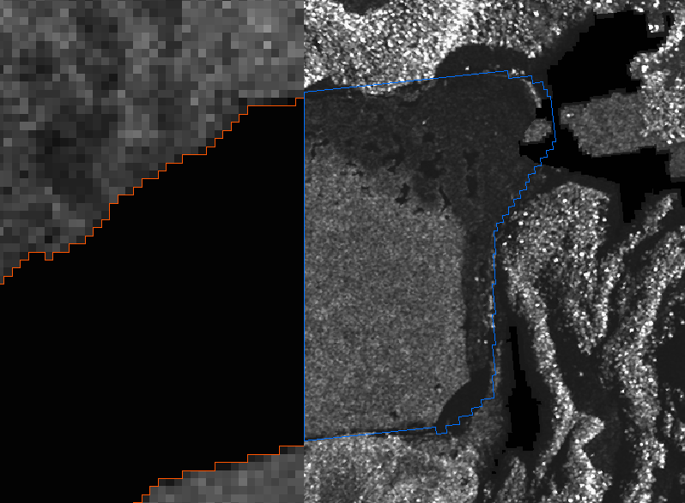
Fugro (orange) on left;
Intermap (blue) on right
Intermap June collect – Ice
Fugro July collect – No Ice

Slide 38
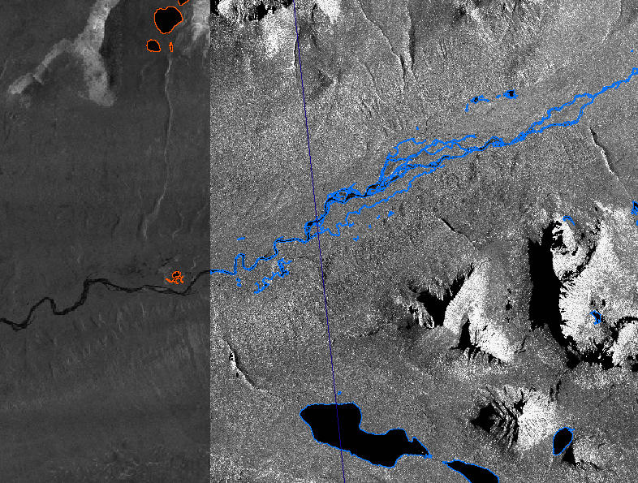
Intermap (blue) collects and hydro-enforces smaller streams beyond project specifications

Slide 39
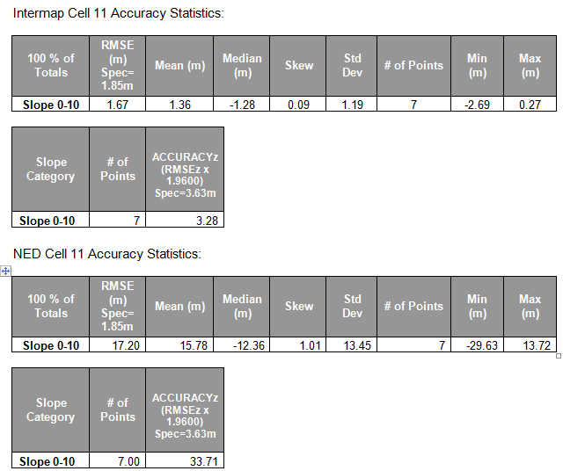
Intermap’s Cell #11 Compared with NED
10.3 X Improvement

Slide 40
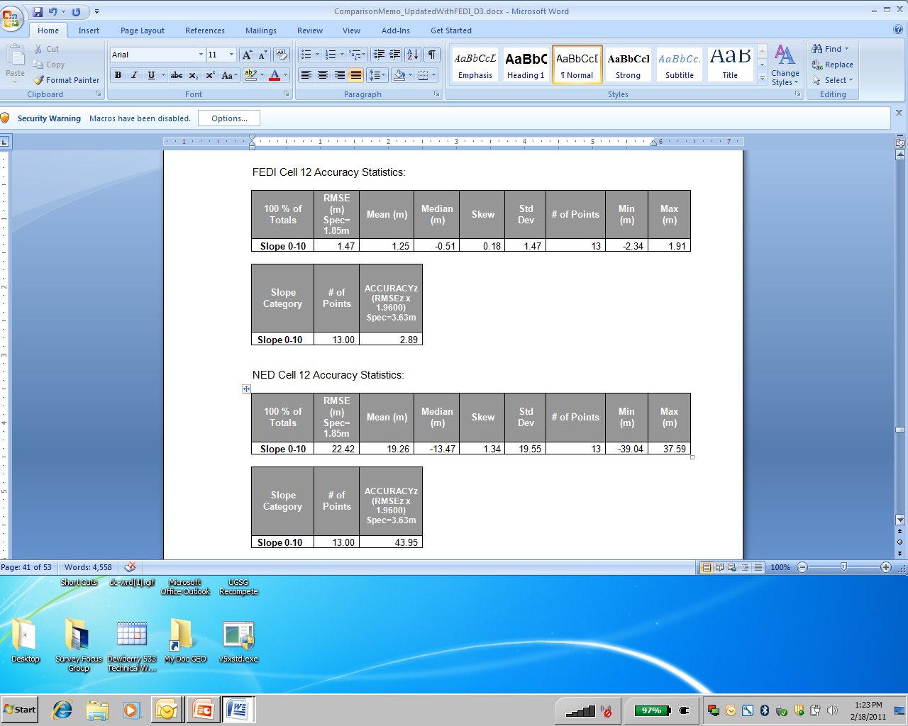
Fugro’s Cell #12 D#3 Compared with NED
15 X Improvement

Slide 41
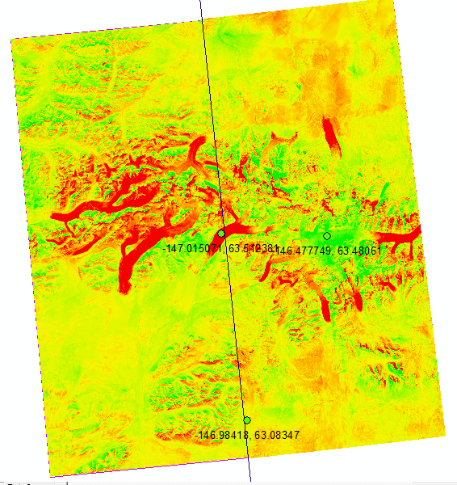
IFSAR Comparison with NED
Difference showing NED data subtracted from both cell 12 (Fugro data on left) and cell 11 (Intermap data on right).
Red areas are where IFSAR data are below the NED data by up to 398 meters
Green areas are where IFSAR data are above the NED data by up to 421 meters.
Compared with IFSAR, the NED elevations are more than 30 meters too low for 7.5% of the area in cells 11 and 12

Slide 42
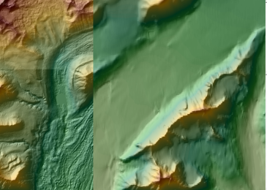
Resolution/content significantly different
IFSAR (left) and NED (right)

Slide 43
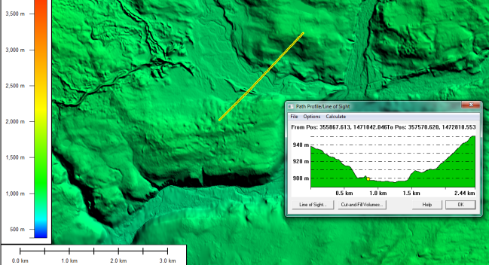
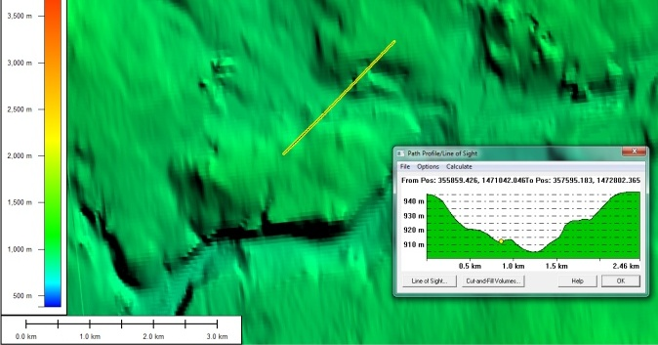
IFSAR (left); NED (right)
Shows inaccurate/obsolete NED cross section

Slide 44


IFSAR (left); NED (right)
Shows ~42 meter NED horizontal error and ~5 meter NED vertical error at highest point

Slide 45
August 2010 Search and Rescue (SAR)
Late August, 2010, month-long search for 4 NPS employees and aircraft enroute to Katmai National Park and Preserve
Bad weather (visibility 400 feet AGL); pilot probably deviated from planned route, causing expanded search area
Needed IFSAR to perform line of sight analyses for some of the other mountain passes to see if conditions would likely allow passage or if they could potentially be ruled out as too hazardous or unlikely, which would allow SAR teams to focus their resources elsewhere
A large amount of time, money and resources were expended on this search and rescue effort in terms of flight time and personnel resources
Ultimately, aircraft parts washed ashore

Slide 46

What is cost of wide-area search?

Slide 47

Panoramic View

Slide 48

What if an F-22 crashes in Alaska?

Slide 49
F-22 Crash, Nov 16, 2010
$150M F-22 from Elmendorf AFB crashed; pilot killed
Rugged terrain, 15 miles southwest of Denali Highway
Rescue teams established base at closed-down wilderness lodge, 60 miles east of Cantwell, the nearest town
Crash site on State selected federal land managed by BLM
Crash site is underwater and located adjacent to a creek
Environmentally sensitive due to composite material of the F-22 (considered HAZMAT upon breakup)
Winter snow and runoff could expose other hazardous parts that contain highly pressurized gasses or dangerous flammable components

Slide 50

F-22 Recovery

Slide 51
Weather/Terrain Challenges for Recovery
Search and rescue operations until Saturday Nov 20th at which point it became a recovery operation
USAF: 3rd Wing, 673d Air Base Wing
USA: Alaska’s 3rd Maneuver Enhancement Brigade
Joint Army-Air Force Tactical Operations Center
6th Engineer Battalion provided logistical and mobility support for recovery operations; LTC Hoffmeister said: “Weather and terrain were particularly challenging, and presented extreme mobility challenges for our vehicles and soldiers.”
Heavy snow and snow storms in steep mountain terrain raised avalanche concerns, especially with Blackhawk and Chinook helicopters with increased rotor wash and sound.

Slide 52
Elevation Data Needed -- Quickly Provided
Existing USGS NED was insufficient to aid in identification of ground safety hazards, establishment of landing zones and slope analysis for potential avalanche zones
Errors >90 meters were identified in the NED
Current imagery was not available; sun elevations at this latitude limited commercial imagery collection until late February
On 11/30/10, USGS asked Dewberry if we could help
Determined crash site on Fugro’s cell #21 which delivered “as is” IFSAR data to Dewberry
Dewberry FedEx’d “as is” IFSAR DTM, DSM and ORI to Mike Davis at Elmendorf AFB on 12/02/10.

Slide 53
Uses of IFSAR Data
Accurate base elevations for 3D modeling and visualization of the surrounding crash site
Analysts added and eliminated LZ’s previously identified
Detailed terrain analysis with increased reliability over NED
Creation of secondary products:
  Establishment of avalanche safety zones
  Ingress/egress route planning
Line of communications analysis, radio repeater deployment
Will support springtime fieldwork and remediation efforts, orthorectification, hazards mitigation, development of field survey strategy; tundra will be damp, wet or muddy
IFSAR data will play a vital role if need arises to build a road into the site or a base camp for further cleanup

Slide 54

Hillshade from 5m IFSAR DEM

Slide 55

Detail View

Slide 56

Final slope analysis for HLZ support

Slide 57


Images of News Story

Slide 58
F22 SAR Summary
One man and one $150M plane crashed in a remote location.
>100 people involved; could have potentially put more people into harms way had the IFSAR DEM not been available.
Human lives are valued at >$1M each; if we put XX people into a valley with unsafe condition without the proper DEM analysis we could potentially have lost lives valued at much more than the cost of IFSAR statewide.
What is the real value of IFSAR data in Alaska?
The F-22 incident occurred within the 10% of the state in which DEM data was collected in 2010. Like Katmai, what do we do the next time where accurate DEM data not available?
DEMs are needed for much more than just traditional applications, DEMs could save lives

Slide 59
Search and Rescue (SAR) Operations
Aviation is dangerous business in Alaska
The first Katmai National Park map tells a significant story of the extent of this SAR effort. They covered some serious real estate.
IFSAR would have assisted at Katmai, as it did for F-22 SAR.
From a resource perspective alone, the cost of the SAR effort for both incidents was very high.
Good elevation data would help to mitigate some of the time and expense down the road in terms of line of sight analysis, terrain and slope analysis, mission planning analysis, ingress/egress analysis, line of communications analysis, 3D rendering/modeling.
IFSAR can also help prevent accidents from happening

Slide 60


FAA’s Strategic Plan
Alaska is listed 8 times; no other state is listed

Slide 61



Slide 62




Again, only Alaska is mentioned by FAA

Slide 63

Circle of Safety Handbook
(CFIT = Controlled Flight Into Terrain)
“According to ‘Alaska CFIT Accidents’³ between 1990 and 1998 aviation accidents in Alaska caused 100 occupational pilot deaths. This is equivalent to an occupational fatality rate of 430/100,000/year, approximately 86 times the occupational fatality rate for all workers in the United States⁴ and nearly five times the national fatality rate for all commercial pilots.⁵ Additionally, this is almost 24 times the rate for other Alaskan workers,⁶ making flying the highest-risk occupation in Alaska.”

Slide 64
Circle of Safety Handbook
Appendix F
“The high occupational pilot fatality rate in Alaska and the high fatality rate associated with CFIT crashes reinforce the importance of addressing this type of crash and examining the associated risk factors. Understanding all the factors that result in a pilot flying a properly functioning aircraft into terrain could help in the design of appropriate interventions at multiple levels within aviation and ultimately result in the reduction of commercial aviation fatalities. “
“Most CFIT crashes are attributed to “pilot error” … These crashes occur when failures occur at all levels, and backup safeguards are inadequate, resulting in the pilot flying the aircraft into a situation in which he is not aware of his surroundings.”
ICAO Area 1 and Area 2 eTOD standards were developed to minimize the risk of CFIT crashes, and Alaska is the only state currently in non- compliance with these ICAO requirements.

Slide 65
National Enhanced Elevation Assessment – Coming to Alaska
Quality Levels | Elevation Source | Horizontal Resolution Terms |  |  | Vertical Accuracy Terms
 |  | Point Density | Nominal Pulse Spacing | DEM Post Spacing | RMSEz in Open Terrain * | Equivalent Contour Accuracy
QL 1 | LiDAR | 8 pts/m² | 0.35 m | 1/27 arc-sec (~1 m) | 9.25 cm | 1-ft
QL 2 | LiDAR | 2 pts/m² | 0.7 m | 1/27 arc-sec (~1 m) | 9.25 cm | 1-ft
QL 3 | LiDAR | 1 – 0.25 pts/m² | 1 – 2 m | 1/9 arc-sec (~3 m) | ≤18.5 cm | 2-ft
QL 4 | Airborne Imagery | 1 – 0.04 pts/m² | 1 – 5 m | 1/3 arc-sec (~10 m) | 46.3 cm – 139 cm | 5 – 15 ft
QL 5 | Airborne IFSAR | 0.04 pts/m² | 5 m | 1/3 arc-sec (~10 m) | 92.7 cm – 185 cm | 10 – 20 ft
* Vertical accuracy is reduced in vegetated land cover categories and steeper slopes
65

Slide 66


