Slide 1
Alaska Statewide Orthoimagery Program Overview
TONY FOLLETT
FEBRUARY 24, 2011

Slide 2
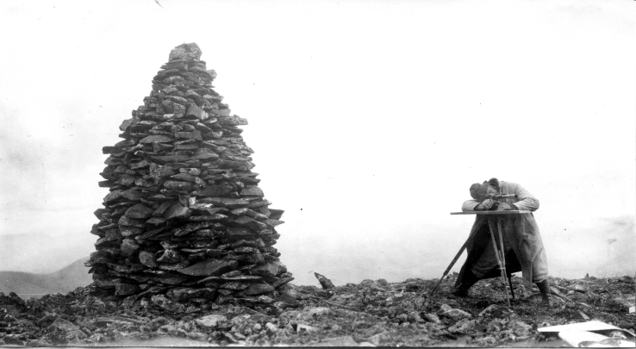
Rufus H. Sargent, topographer at work near cairn on station XLVIII, Southwestern Alaska region. July 31, 1914.

Slide 3
Overview
Orthoimagery Team
Contract Scope
Workflow
Challenges
QA / QC
Examples
Destination

Slide 4


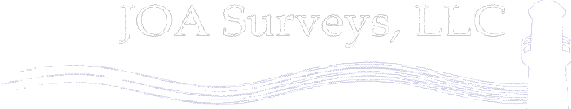

Alaska Statewide Digital Orthoimagery Team

Slide 5
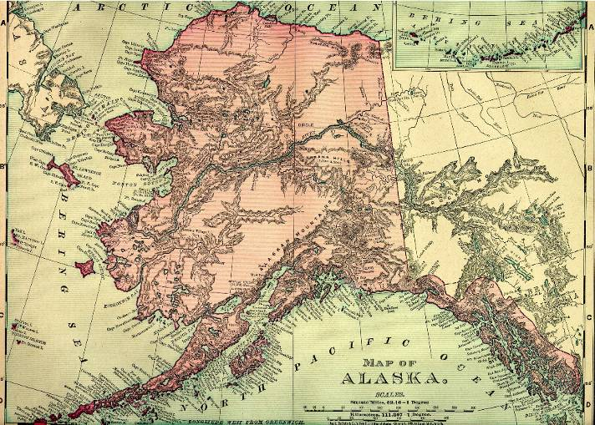
Assignment: Provide satellite-based 1:24,000 orthoimagery of entire state

Slide 6
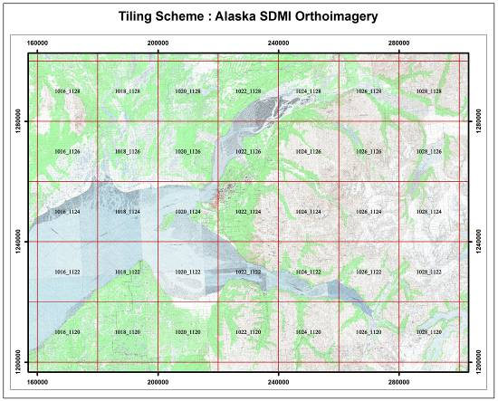
Geographic Area
1,561,622 sq km including 1-km buffer
4,608 tiles, 20K x 20K meters, 8K x 8K 2.5m pixels

Slide 7
Deliverables
  Project management plan including team organizational initiatives
  Source imagery and metadata
  Orthomosaic imagery tiles, natural color & panchromatic with metadata
      DEM
      AT results
      Natural color data
      Panchromatic data
  Orthomosaic imagery tiles, color infra-red with metadata
  Project horizontal and vertical control
      Existing control
      Newly acquired control
  QA / QC reports
  Production files

Slide 8
Standards
    Projection
        Albers Equal Area Conic Projection
    Datums
        NAD83 CORS96 Epoch 2003
        NAVD88 Geoid09-Alaska
    Accuracy
        NMAS, CE90 40 feet (12.2m)
    Cloud cover
        < 10% per Spot satellite scene

Slide 9
Schedule
Start
  Aug 5, 2010
Project Management Plan
  2nd version April 30
Pilot Project
  complete
Source Imagery & Metadata
  10 working days after collection
Orthomosaic imagery tiles & supporting information
  Apr 30, 2011, Feb 28 2012, 2013, 2014
Project completion
  June 30, 2014

Slide 10
Workflow
Imagery: Astrium to SDMI, Fugro, AeroMetric
Control: AeroMetric to Fugro
DEMs: AeroMetric to Fugro
AT results & orthomosaics: Fugro to AeroMetric
Deliverables: AeroMetric to SDMI

Slide 11
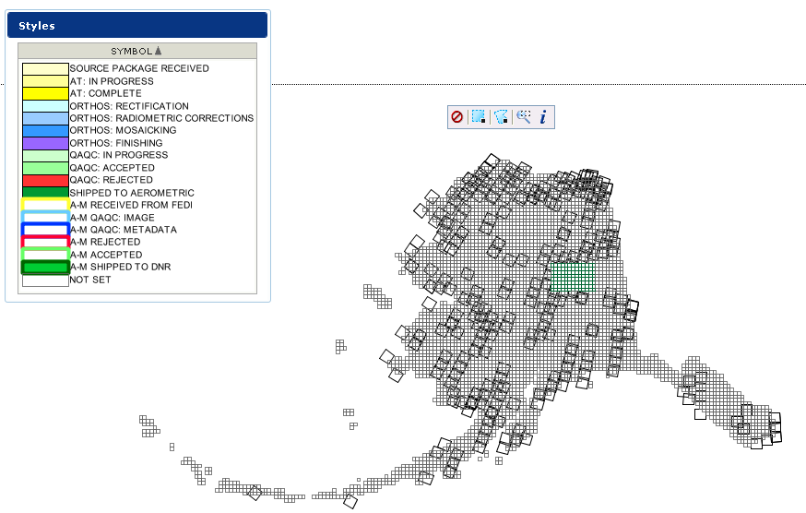
Web enabled production tracking system

Slide 12
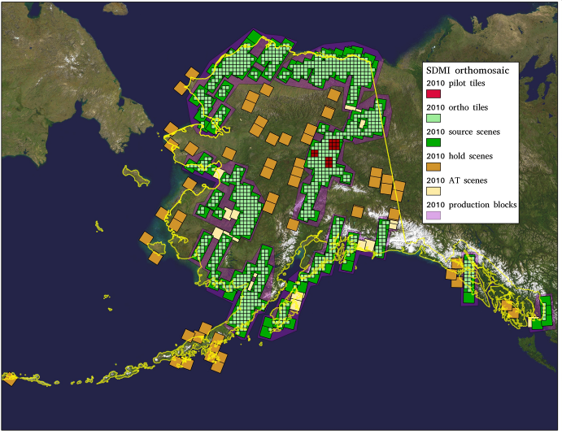
Production Blocks

Slide 13
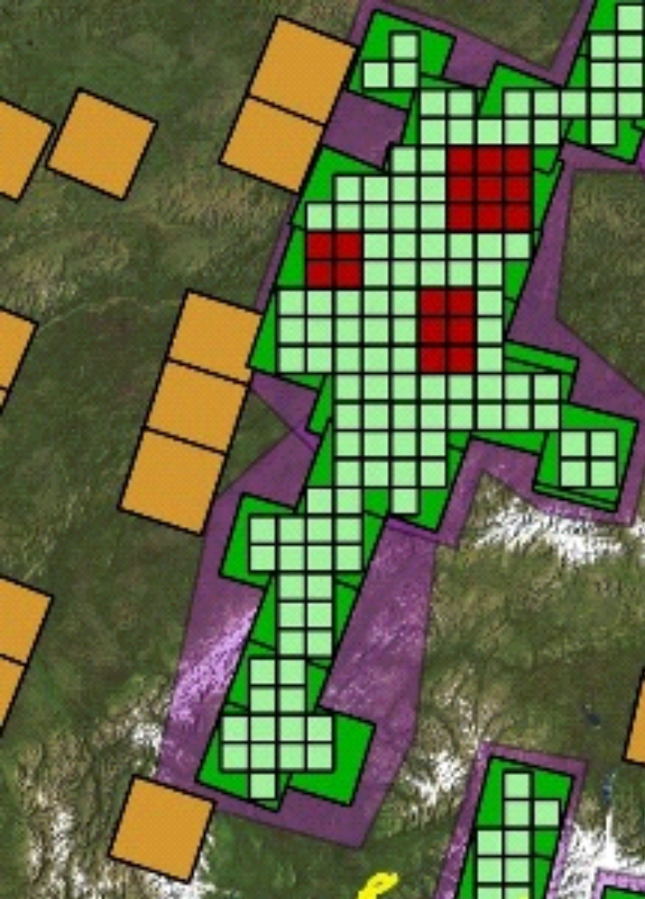
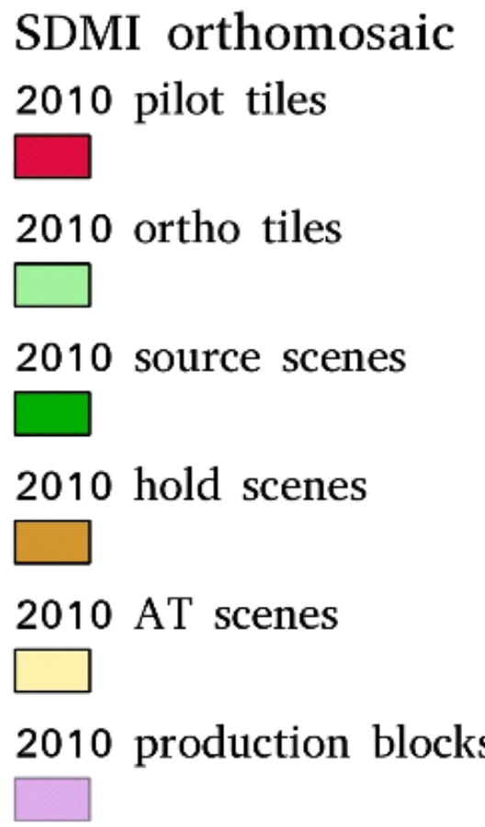
Production Block – pilot area

Slide 14

Challenges – Imagery Collection

Slide 15

Challenges – Imagery Collection

Slide 16
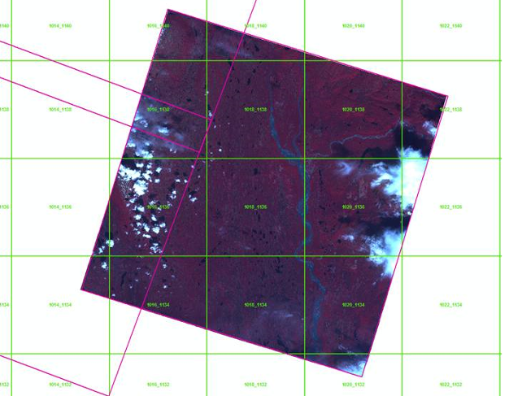
Challenges – Minimizing Cloud Effect

Slide 17
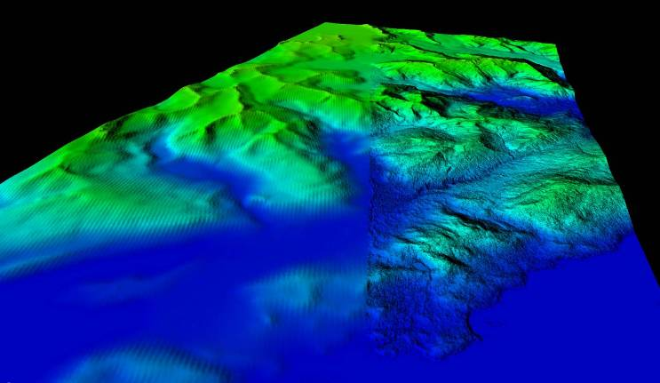
Challenges – use of existing DEMS
2 arcsec NED 5 m IFSAR

Slide 18
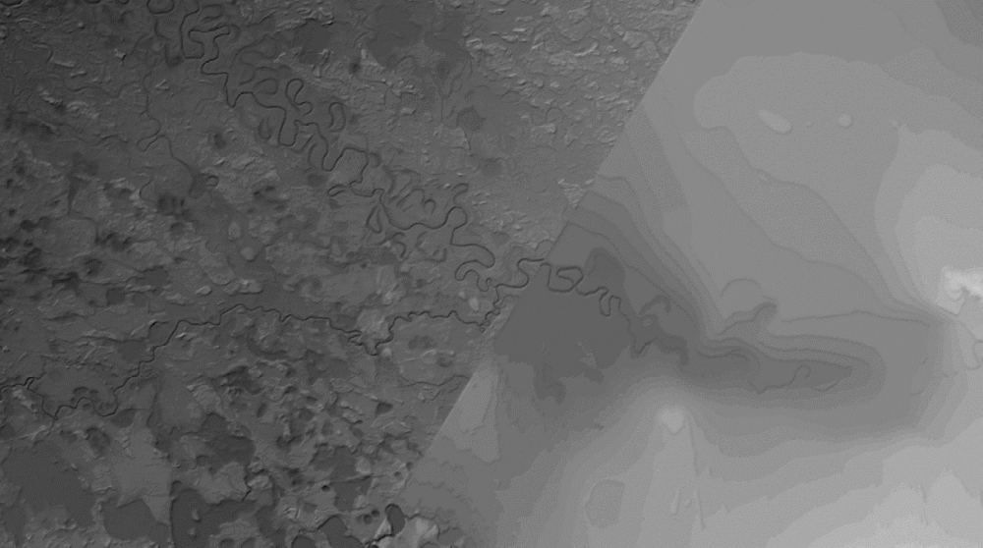
Challenges – use of existing DEMS
Yukon Flats – shaded relief
1/3 arcsec NED Nov/Dec 2010
from lidar
NED base data

Slide 19
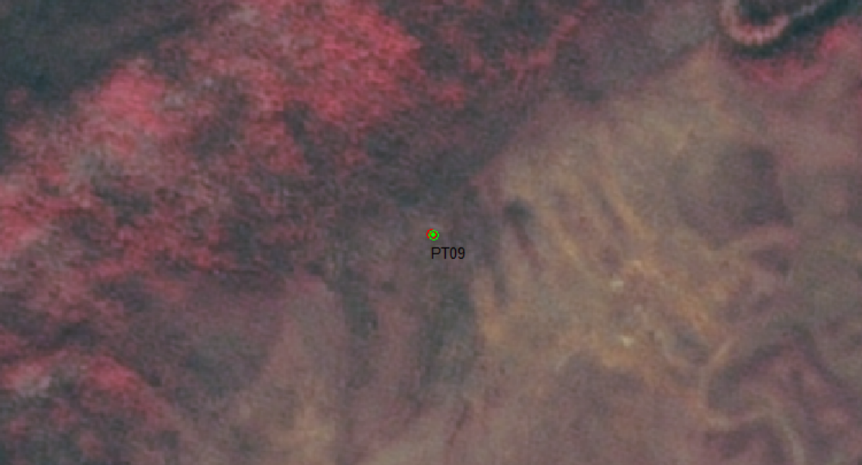
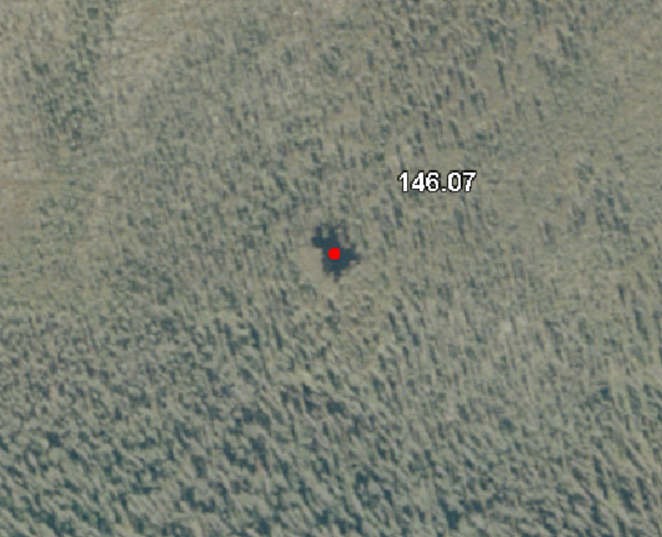
Challenges – use of existing control

Slide 20
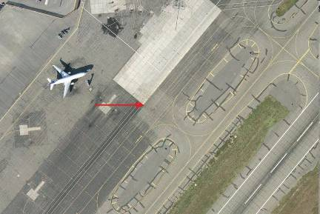
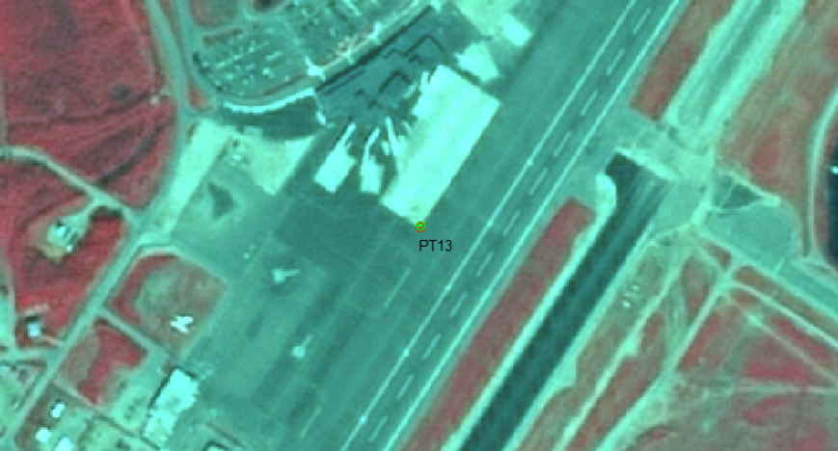
Challenges – use of existing control

Slide 21
QA / QC Procedures
Control
DEMs
Orthomosaics

Slide 22
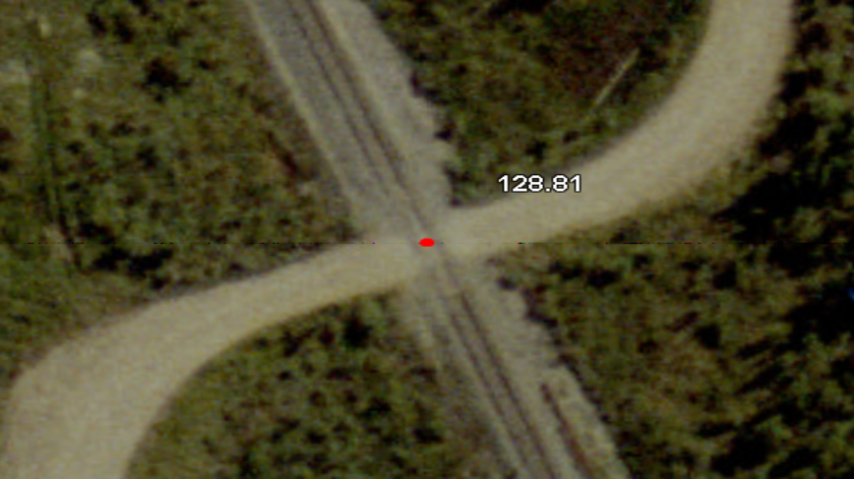
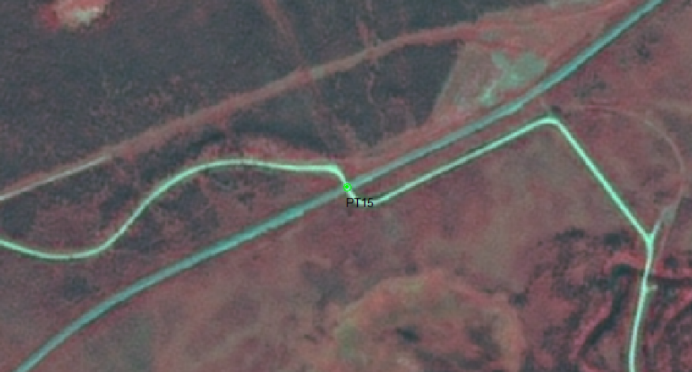
Control

Slide 23
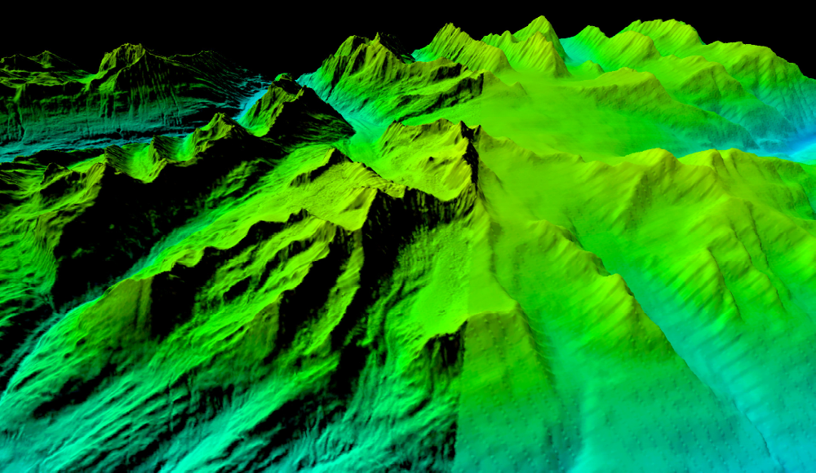
Existing Merged DEM

Slide 24
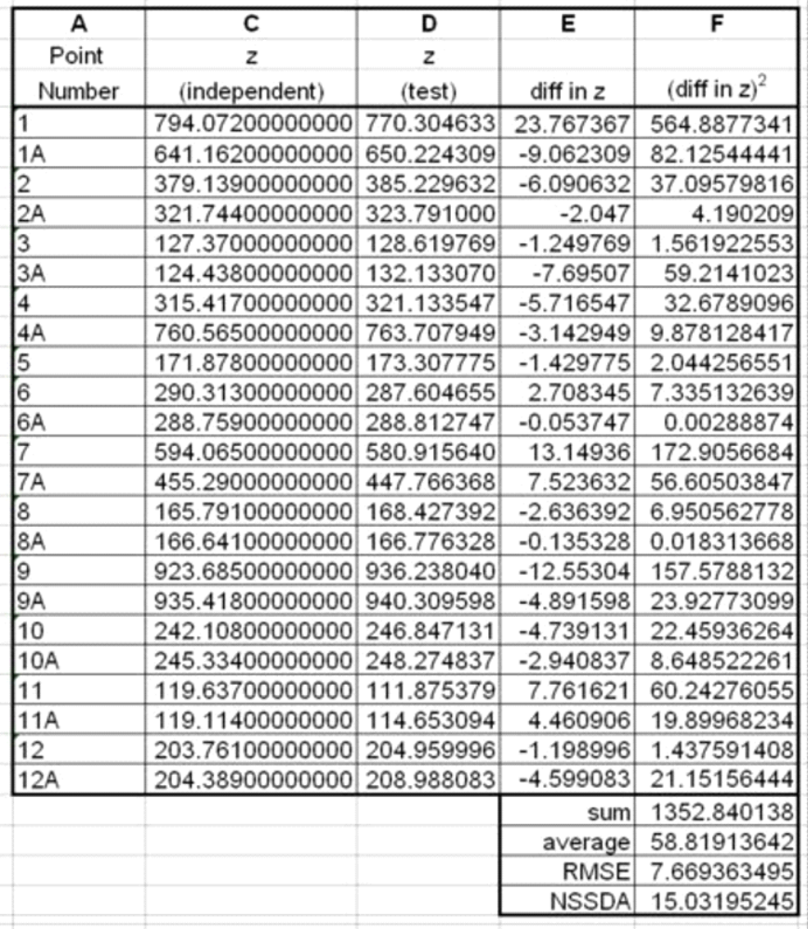
Vertical Analysis of NED DEM –
FGDC Accuracy Spreadsheet

Slide 25
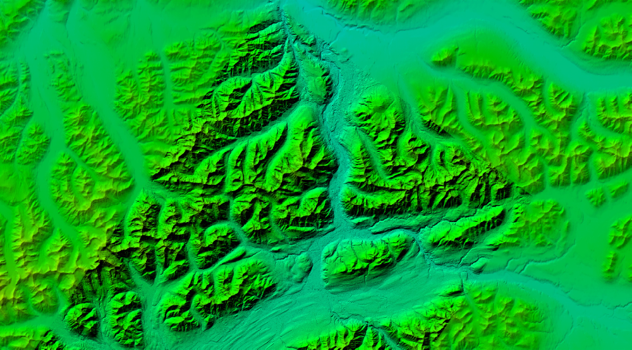
Accuracy Mask for DEMs

Slide 26
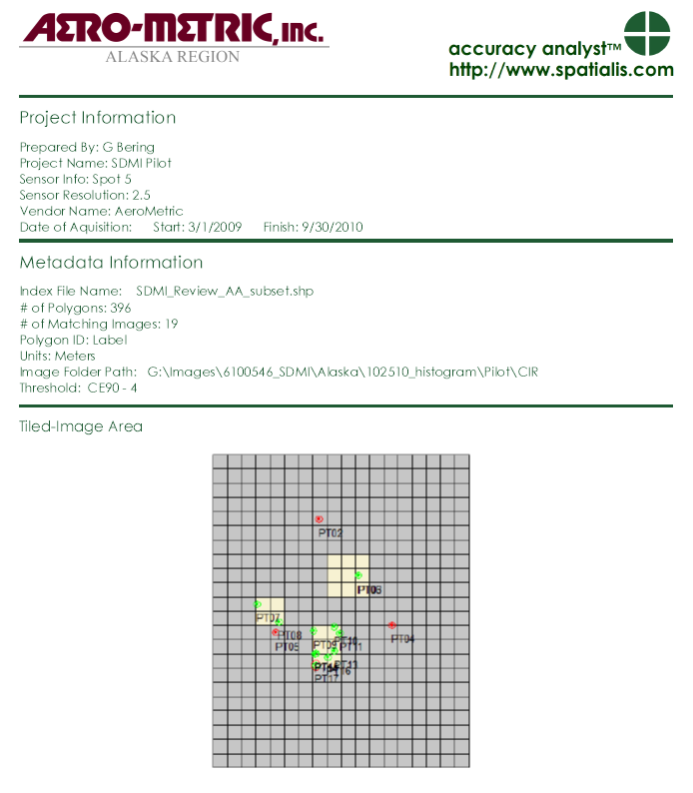
Example Orthomosaic QC

Slide 27
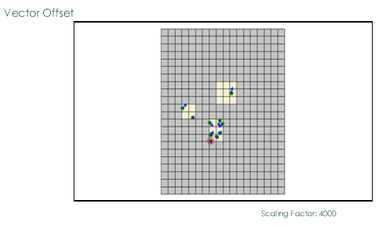
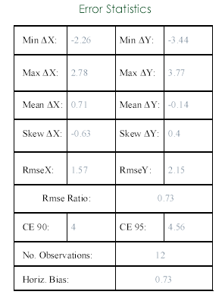
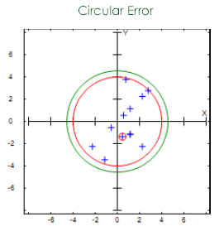
Example Orthomosaic QC

Slide 28
Example Deliverables
CIR
Color
Panchromatic

Slide 29
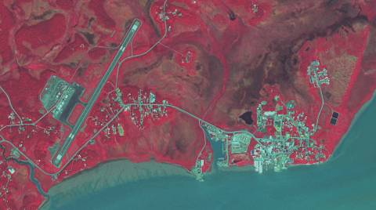
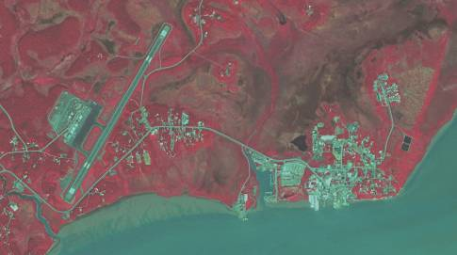
CIR Sample Histogram Balances

Slide 30
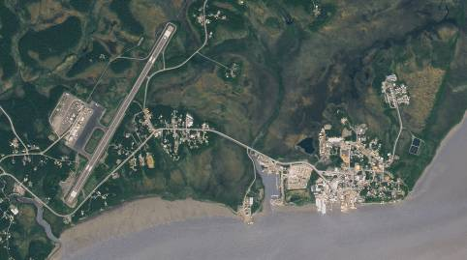
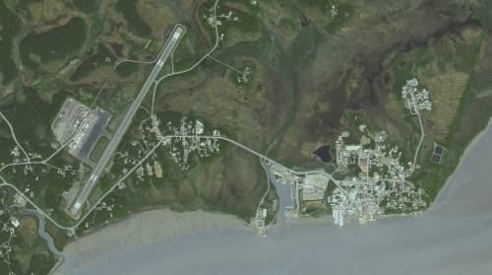
Color Sample Histogram Balances

Slide 31
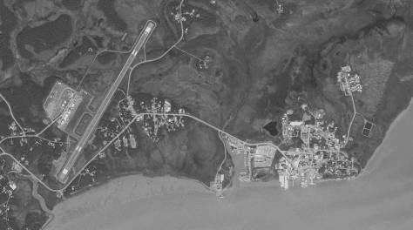
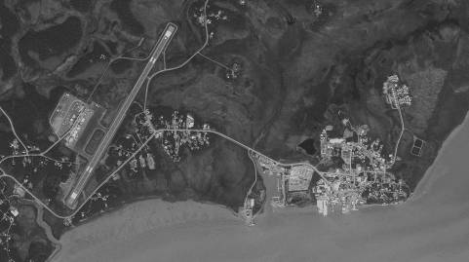
Panchromatic Sample Histogram Balances

Slide 32
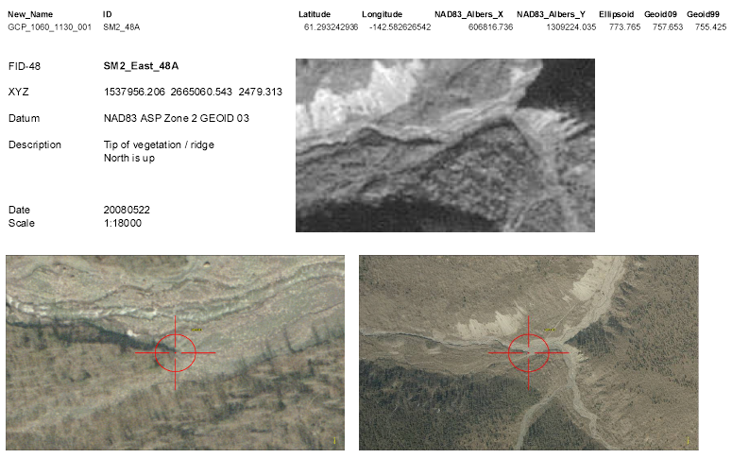
Existing Control Record

Slide 33
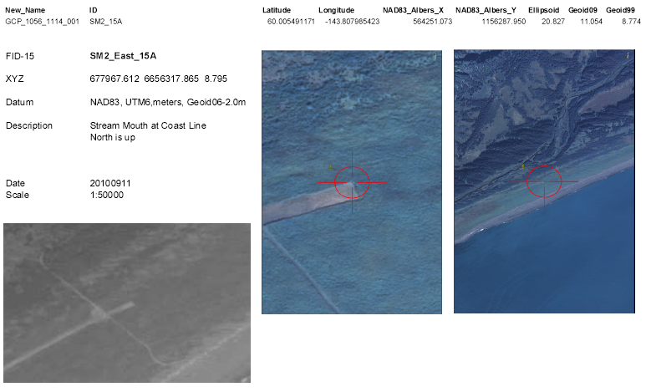
Existing Control Record

Slide 34

Deliverables Destination

