Slide 1
SDMI Source Imagery Collection
Updating Alaska’s image maps
Drew Hopwood
February 24, 2011

Slide 2




GEO-Information Services within Astrium and EADS
Telecommunications
Secure Satcom Systems
GEO-Information
Navigation
Astrium Satellites
Astrium Services
Space Transportation
Airbus
Eurocopter
Astrium
Cassidian

Slide 3

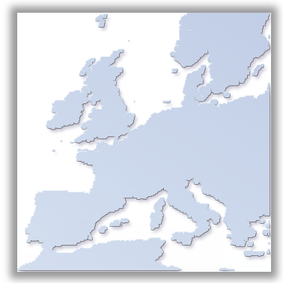



Corporate Overview
Strong Global Presence
  Staff: +900, located in 12 countries
  North American office located in
  Chantilly, VA
Balanced Portfolio
  Optical & Radar Geo-Imagery
  Change Detection & Monitoring Services
  Global, Highly Accurate DEMs
Extensive Satellite & Imagery Resources
  Satellites in Operation: SPOT 4 & 5, TerraSAR-X & TanDEM-X
  World’s Most Extensive Network of Direct Receiving Stations
  Upcoming Very High-Resolution Satellites: Pléiades 1 & 2
  SPOT 6 & 7 Continuity Program
  Distribution Rights for Other Satellites: FORMOSAT-2, KOMPSAT-2, DEIMOS-1
Infoterra UK
Infoterra
Germany
Spot Image
Corporation
Spot Image
Infoterra Hungary
Infoterra Spain
Beijing
Spot Image
Tokyo
Spot Image
Spot Infoterra Hellas
Infoterra AP
Spot Image
Brasil
Spot Asia
Spot Imaging
Services

Slide 4
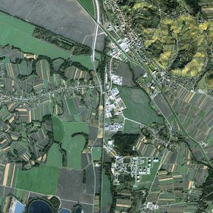
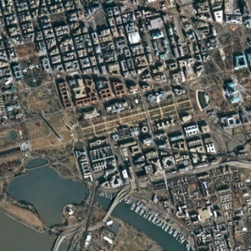
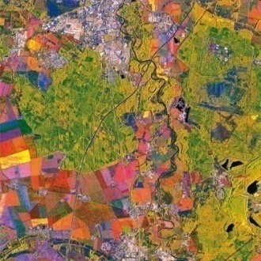
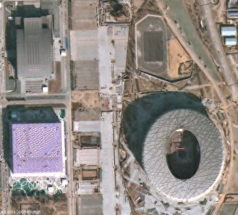
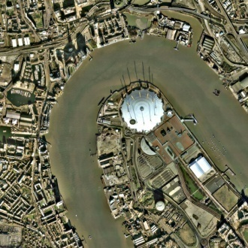
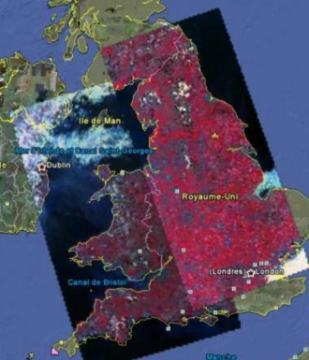
Optical & SAR Imagery
SPOT-4 & -5
2.5m -20m Optical Data
60km x 60km Image Swath
100+ Billion km² Archive
FORMOSAT-2
2m Optical Data
Daily Revisit
Great for Site Monitoring
TerraSAR-X
SAR Imagery -
Up to 1m Resolution
Weather-independent
Unrivalled Access
KOMPSAT-2
1m Optical Data
Image Swath
Very High Resolution
Large-scale Mapping
DEIMOS-1
22m Optical Data
600km Image Swath
Daily Revisit
Cloud-free coverage of the UK in two images!
Pléiades-1 & -2
50cm Optical Data Products
Daily Revisit
95% of Resources Dedicated to
the Commercial Market

Slide 5
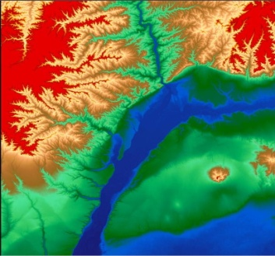
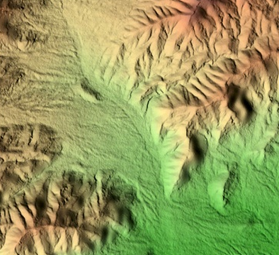
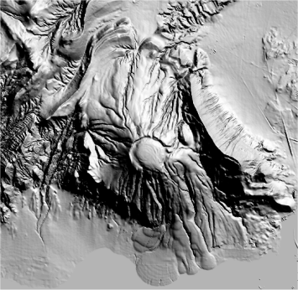
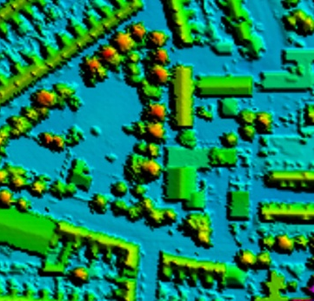
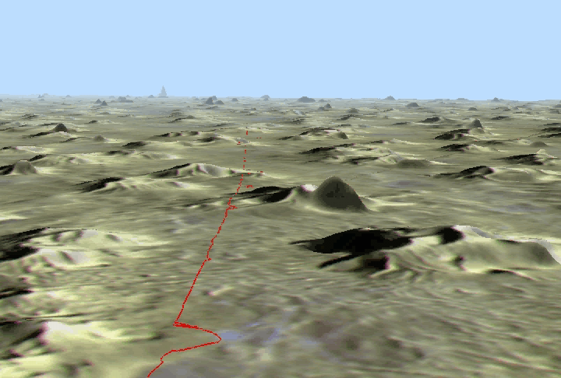
Elevation Datasets
Reference3D
DTED-2
Ortho Image & Quality Masks
120+ Million km² Coverage
SPOT DEM
20m Post Spacing
49 Million km² Off-the-shelf
TerraSAR-X
Radargrammetry DEM
10m Post Spacing
Weather-independent
Unrivalled Access
TanDEM-X
Satellite IFSAR DEM
Global Collection Plan
High Accuracy
LiDAR
DEM, DTM, DSM
10cm – 2m Posts
Sub-meter Accuracy
HR Stereo Pairs
Satellite or Aerial based data
High Accuracy
On Demand Processing

Slide 6
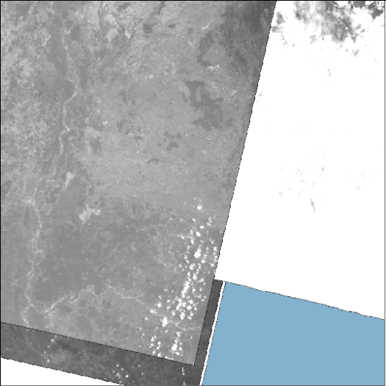
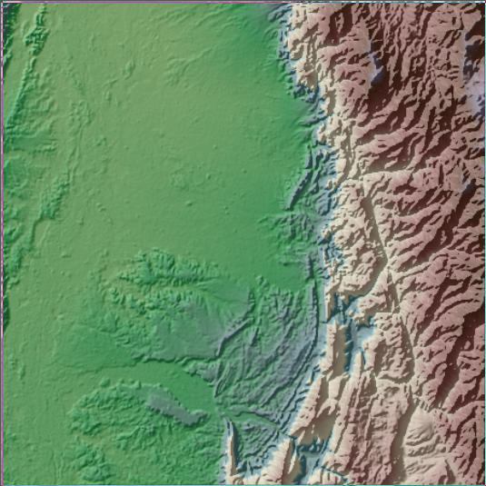
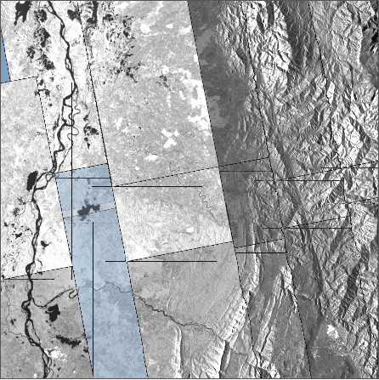
Hybrid Elevation Solutions
SPOT DEM
Void Free DEM
TerraSAR-X DEM

Slide 7
Hybrid Elevation Solutions
SPOT DEM
Hybrid DEM
Increased coverage over cloudy regions
Cost effective
Constant quality
TerraSAR-X DEM

Slide 8
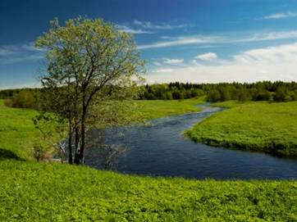
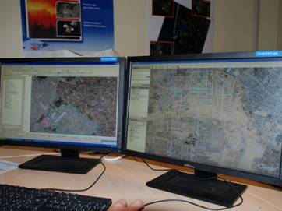
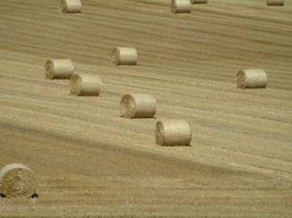
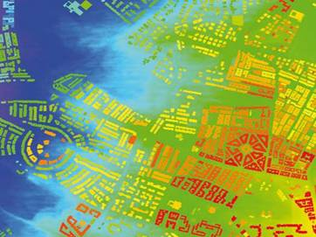
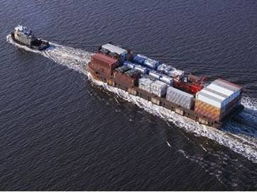
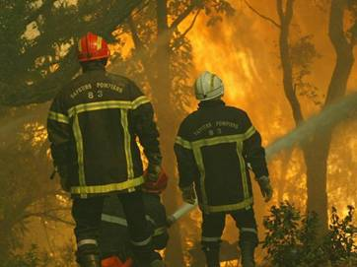
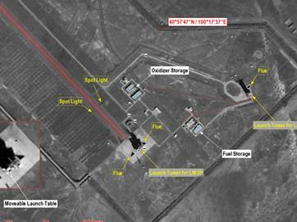

Serving Versatile Application Needs
Environment &
Forestry
Mapping &
Land management
Agriculture
LBS &
Navigation
Maritime & coastal
Risk & crisis
management
Defense & Security
Oil & Gas, Mines

Slide 9
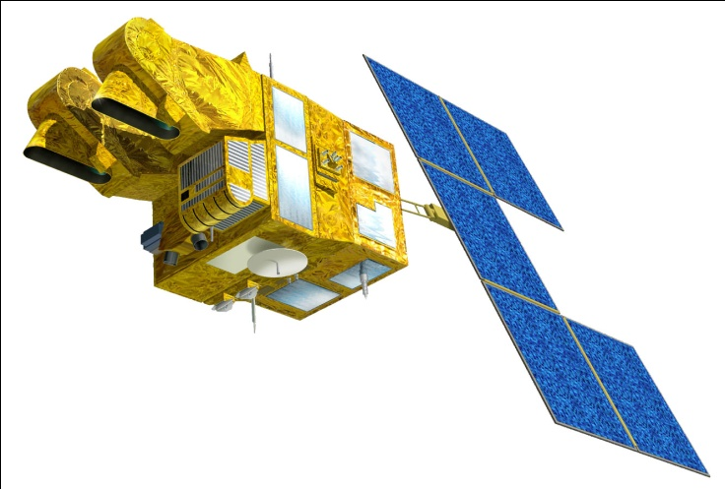
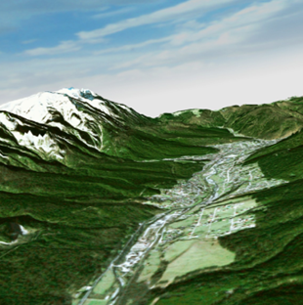
SPOT 5 in Alaska
HRG2
SPOT-5
  2 High Resolution Geometry (HRG) Instruments
    2.5m & 5m Panchromatic
    10m 4-Band Multispectral
      Green, Red, NIR, & SWIR
  High Resolution Stereo (HRS) Instrument
    DTED-2 DEM (Reference3D)
    20m Post Spacing DEM (SPOT DEM)
  Vegetation (VGT) Instrument
HRG1
HRS
VGT
SDMI Ortho Imagery Source
  2.5m Pan & 10m MS Scene Bundles
US Forest Service
  Copper River Delta Project
  HRS DEMs in the Chugach and Tongass National Forests
Woods Hole Research Center & UAF
  Vegetation Responses to Climate Change
    More information http://www.planet-action.org/web/85-project-detail.php?projectID=1571

Slide 10
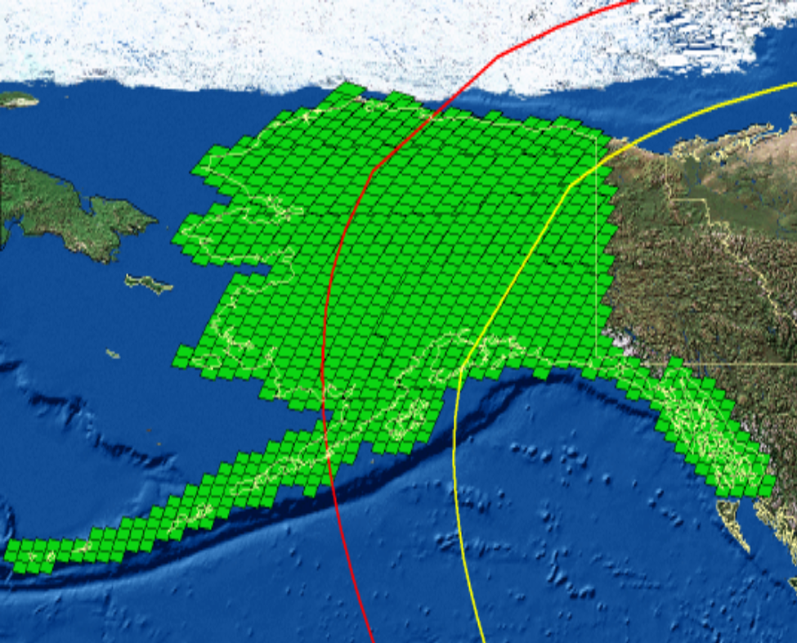
SDMI Source Imagery Requirements
Collect Upland Alaska
  ~1.56m km²
  ~900 SPOT-5 scenes
Sun Angle Above 30º
  Shortens Collection Season in Northern Areas
Leaf-on
Less than 10% clouds
  Also Cloud Shadow, Hazy, Smoke & Snow
Ortho Accuracy 1:24k
  Collection Limit: +/-15º Off Nadir

Slide 11
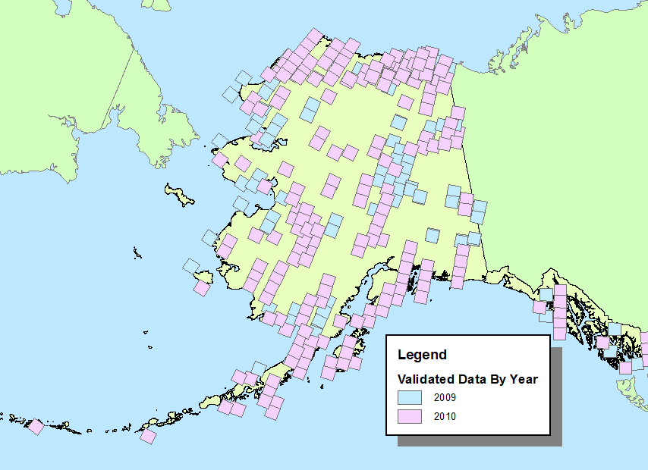
Current Source Imagery Collection Status
Collected 294 Scene Bundles
Covering 603,000km² or 39% of Alaska

Slide 12

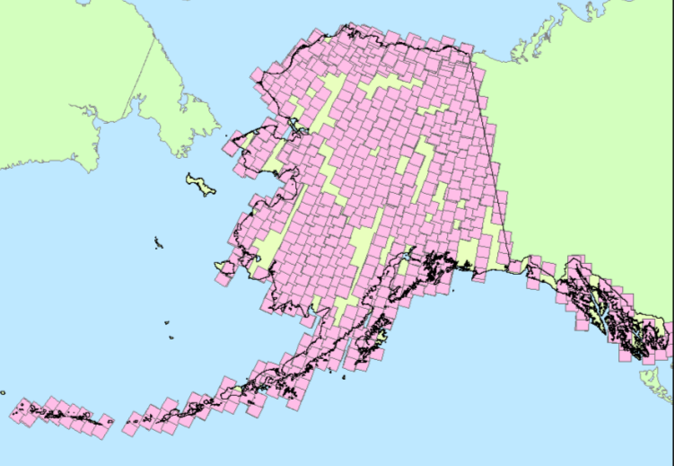
2010 Collection Overview
Delivered
Bundles Collected | 1271
Bundles Delivered | 210
Delivery Percentage | 16%
Factors Limiting 2010 Delivery
  Clouds
  Sun Angle
Collected

Slide 13
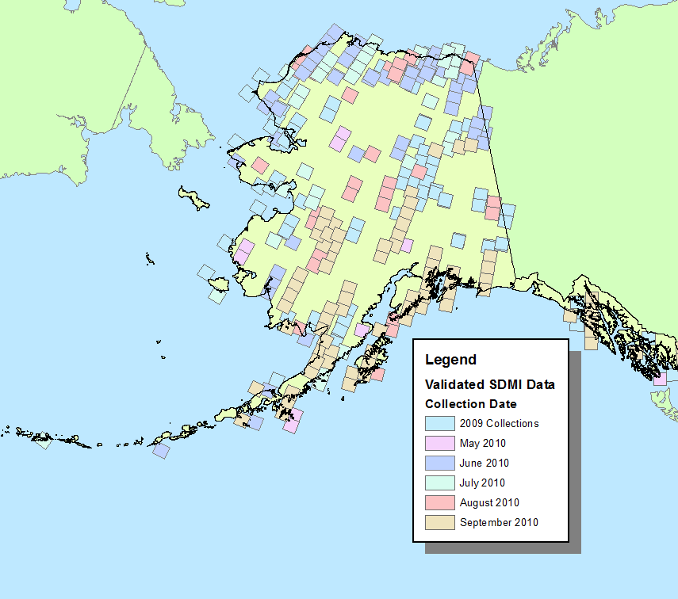
Clouds
More Challenging Than Anticipated
  July was the most challenging
    From July 14 to August 1, no imagery was delivered because of heavy clouds.
  Conditions improved in September
16%

Slide 14
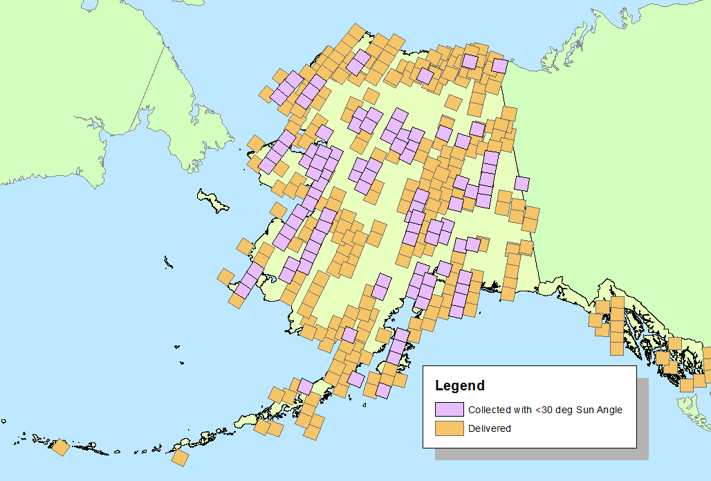
Sun Angle
Starting in September, the sun angle requirement limited the amount of deliverable data bundles.
Clearing weather conditions in September increased the amount of near cloud-free scene bundles being collected; however, the sun angle requirement prevented them from being delivered.
  In total, 111 scene bundles were collected, which met all delivery criteria except the sun angle.
  Increased total coverage to 48%

Slide 15
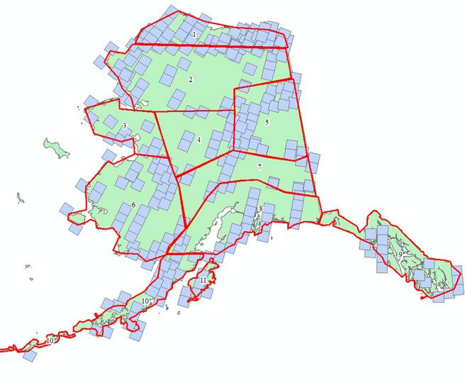
2011 Collection Season
Anticipated Delivery: 200 – 300 Scene Bundles
Complete Collection of the North Slope
Gather Input On User Priorities
  Discussion Friday Morning

Slide 16

Astrium
GEO-Information Services
Drew Hopwood
14595 Avion Parkway, Suite 500
Chantilly, VA 20151
(703) 715-3100

Slide 17
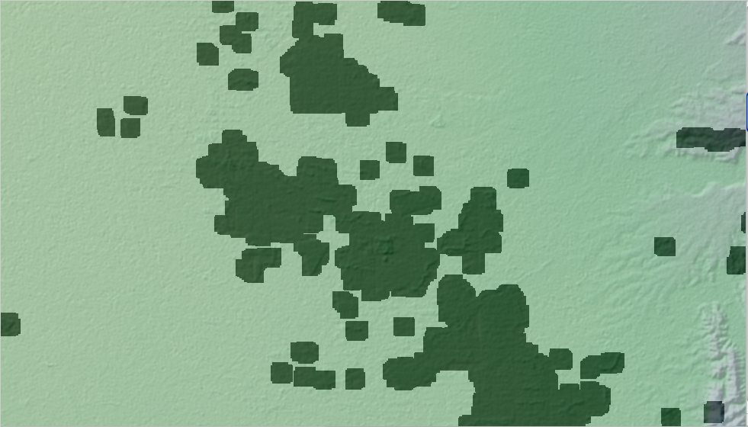
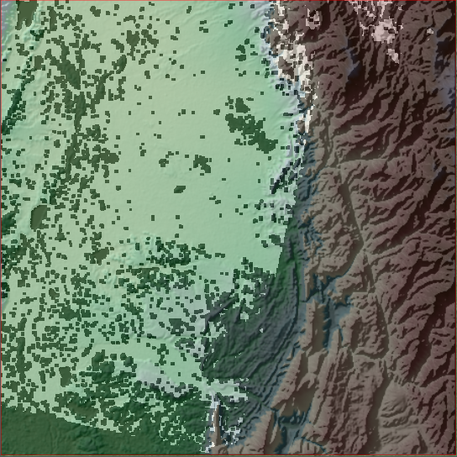
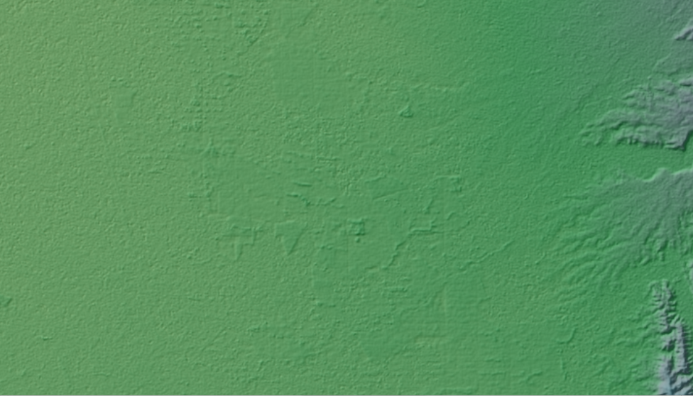
TSX/HRS DEM MERGING

Slide 18
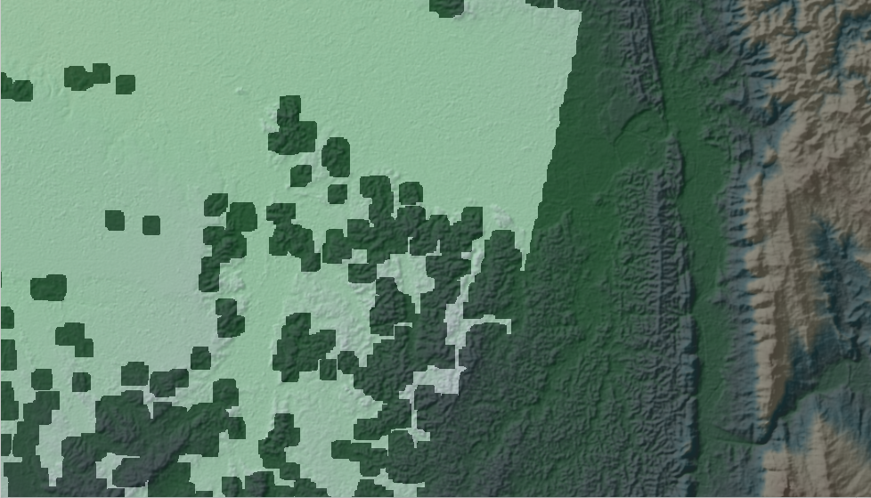
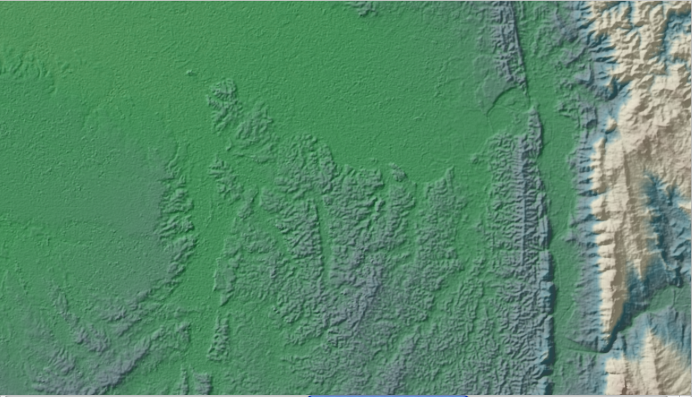
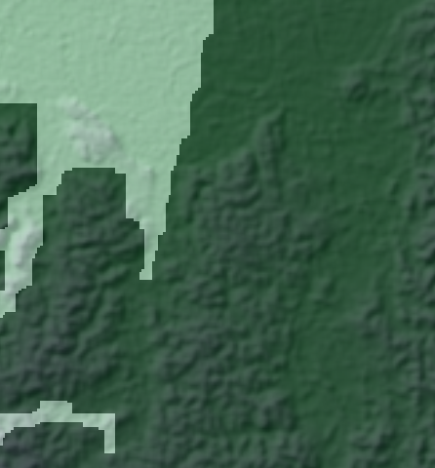
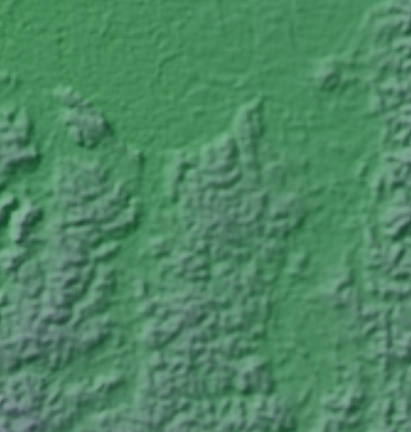
TSX/HRS DEM MERGING

